Slide 1



MPEG-TS / IP support option on
IQOYA X/LINK & SERV/LINK Available through software licence

Slide 2

WHAT IS MPEG-TS?
The MPEG Transport Stream protocol (MPEG-TS, TS for short) is a standard from the Moving Picture Experts Group that defines the transport aspects across networks for digital television.
PRIMARY PURPOSE
To allow the multiplexing of video and audio in order to synchronize the whole.
1

Slide 3

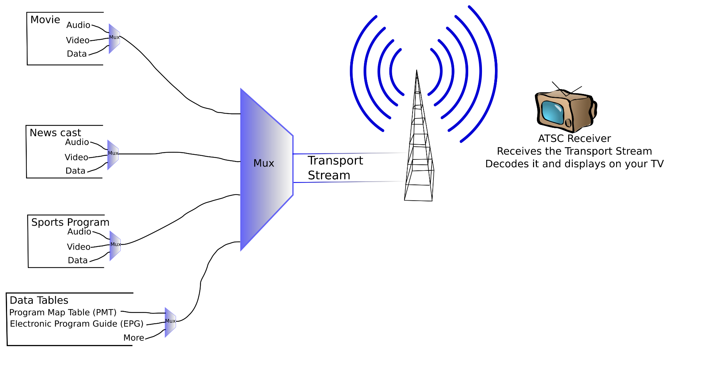

WHAT IS MPEG-TS?
An MPEG-TS stream can include several audio/video programs, as well as program and service description data.
Example scheme of IRD (Integrated Receiver Decoder)

Slide 4


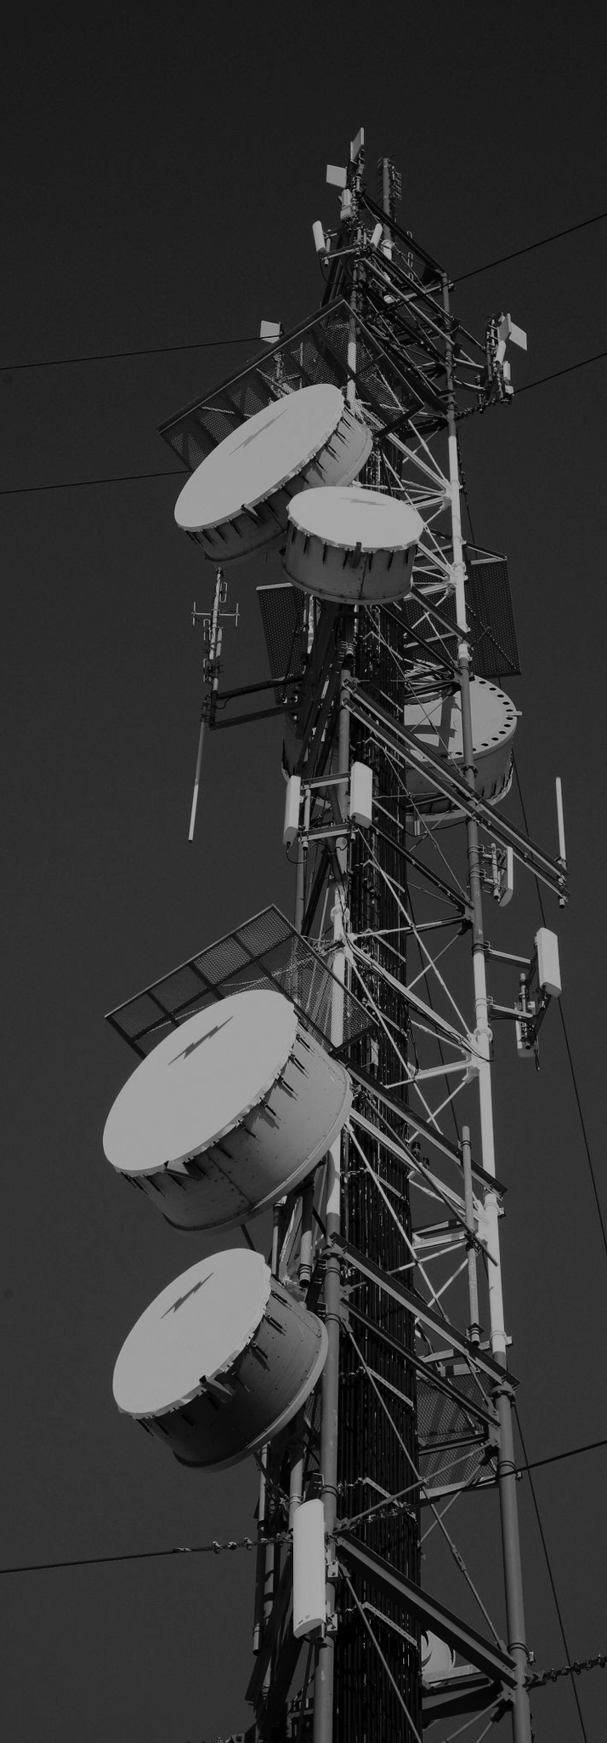
Applications using MPEG-TS.
Where MPEG-TS makes the difference
REMOTE PROD OF MOTOR SPORT EVENTS
DIGITAL BROADCASTING
TOWER COMPANIES
Transport multiple channels over a WAN keeping the interchannel synchronisation unchanged thanks to the MPEG-TS encapsulation.
Take raw audio from a studio sources, compress it, and wraps it into an MPEG-TS stream for satellite or terrestrial transmission.
MPEG-TS encapsulation to standardize the transport and monitoring of video streams and audio streams

Slide 5

Zoom on FM distribution via DVB.
Collect multiple IP streams coming from the regional studios
For each regional stream, setup a failover to the national program
Encode and stream in MPEG-TS MPTS all the resulting regional audio contents, with 1+1 hot redundancy

Slide 6


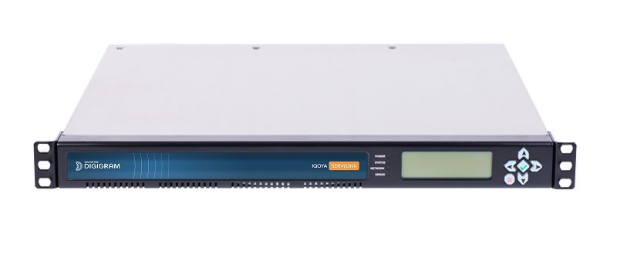

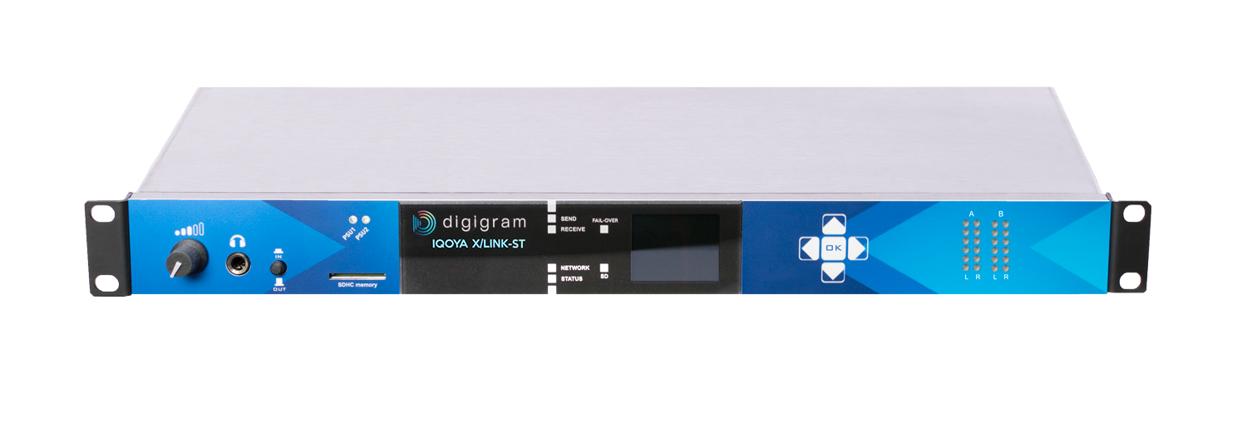

Zoom on FM distribution via DVB.
64 stereo multicast RTP/IP streams with FEC
1 MPEG-TS/IP stream with up to 64 stereo PGM’s with Pro MPEG Cop#3 FEC
MPLS A
MPLS B
Regional stations
National station
DVB Operator
FM Tx Sites
DVB Mux.
Multicast RTP/IP streams with FEC
AES3
IQOYA X/LINK-ST
IQOYA SERV/LINK
Life line
VLAN
IQOYA X/LINK-ST
IQOYA SERV/LINK
Up to 64 regional studios
Control & Monitoring

Slide 7


Zoom on Remote
Production of Sports Events.
Transport multiple audio channels from the sports venue to the production studio
Keep the interchannel synchronisation unchanged
Deliver high-quality audio

Slide 8






Zoom on Remote Production.
64-channel MPEG-TS MPTS RIST trransport protocol
WAN
Moto GP RACE TRACK
PRODUCTION CENTER
Ambient
64-channels - interchannel sync unchanged AES67, ST2110 or DANTE
DANTE
64 channels
AES67
DANTE
Paddock
IQOYA SERV/LINK DANTE
IQOYA SERV/LINK
Race track
Race direction

Slide 9
MPEG-TS for
IQOYA RANGE
X/LINK & SERV/LINK

Slide 10
IQOYA products eligible to the MPEG-TS option.
VB2342A0101 | IQOYA X/LINK-LE
VB2331A0101 | IQOYA X/LINK-ST
VB2388A0101 | IQOYA X/LINK-DUAL
VB2389A0101 | IQOYA X/LINK-AES67
VB2247A0103 | IQOYA SERV/LINK 882
VB2247A0203 | IQOYA SERV/LINK 16162
VB2274A0502 | IQOYA SERV/LINK 88 - AES67
VB2274A0602 | IQOYA SERV/LINK 7272 - AES67
VB2409A0103 | IQOYA SERV/LINK 88 - DANTE
VB2409A0203 | IQOYA SERV/LINK 7272 - DANTE
VB2275A0103 | IQOYA SERV/LINK 88 - TC

Slide 11
Firmware versions.
 | MPEG-TS Encoding | MPEG-TS Decoding
Availability | Included | Optional (software licence)
X/LINK Fw version | 2.01 | >= 4.01
SERV/LINK Fw version | 2.16 | >= 4.12 | >=5.01
Stream types | Several SPTS and/or 1 x MPTS
Supported audio formats | MPEG-L2, MPEG L3, AAC-ADTS (LC, HEv1, HEv2)
Forward Error Correction | Pro MPEG COP#3 FEC
Transport of Ancillary data | Serial data / triggers
RIST transport | Yes
New hardware platform since January 2026

Slide 12
Digigram References & Pricing
To benefit from the MPEG-TS decoding option the equipment, start by activating it on your equipment:
 | Product | Description | MSRP EMEA+APAC | MSRP US
LD234800101 | X/LINK (except -MPX) | Option MPEG-TS decoding | 350 € | $440
LD227900101 | SERV/LINK |  | 950 € | $1185

