Slide 1

RIST protocol option for
IQOYA X/LINK & SERV/LINK Available through software licence

Slide 2
WHAT IS RIST?
Reliable Internet Stream Transport
Reliability Over Imperfect Networks
Purpose-built for the "lossy" nature of the public internet, RIST ensures broadcast-quality delivery of video and audio without the need for expensive dedicated fiber lines.
Ultra-Low Latency, High Quality
Achieves the "holy grail" of streaming by maintaining high-definition integrity while keeping delays to a minimum—essential for live sports, news, and interactive content.
Open and Interoperable
As an open-source and open-specification protocol, it prevents vendor lock-in. It allows different hardware and software systems to communicate seamlessly.
Intelligent Bandwidth Management
RIST uses retransmission bandwidth throttling. This prioritizes stream continuity, ensuring the link stays alive and maintains maximum possible quality even when network speeds drop.
Scalable Versatility
RIST is not a "one size fits all" solution. It offers multiple profiles, allowing users to scale from simple point-to-point delivery to complex, high-security enterprise configurations as needs evolve.

Slide 3






WHY RIST?
AES-256
ENCRYPTION
Keeps low latency
The superior choice for high-stakes professional broadcasting
Uses less bitrate than FEC
Includes stream encryption capabilities
Guarantees interoperability between vendors
Natively supports multi-link transport
Guarantees stream confidentiality

Slide 4
RIST vs SRT.
RIST
SRT
Latency
Low (Tunable and fixed)
Reliability
Good (via ARQ)
Bandwidth Management
Advanced Throttling
Basic retransmission
Multi-Link support
Native Bonding/Seamless
Limited / Experimental
Encryption
Both technologies use AES (Advanced Encryption Standard) with 128 or 256-bit keys
No one can listen to a stream without the key
Dynamic key negotiation, secured key distribution protocols and authentication of end-points
No standard for authentication, only shared key, no automatic rotation (dynamic distribution) of the key
Authentication
Interoperability
Guarantees the interoperability between devices from different vendors
Depends on the implementation made by each manufacturer
Performance
More robust on poor quality networks
Adapted to quite stable network conditions

Slide 5


RIST Profiles.
Simple
Main
Interoperable Automatic Repeat reQuest (ARQ) with configurable behaviour for recovery of packet loss, packet reordering and link failure
Removal of network introduced jitter
Transport of point-to-point dual stream services
Bonding of several links using link aggregation (multipath)
Transport of point-to-multipoint services
Stream encryption for secure content
VPN tunnelling for secure sender/receiver communication
NAT traversal for improved interworking
with consumer-style internet connectivity
Null packet suppression for saving bandwidth

Slide 6
RIST in the
IQOYA RANGE
X/LINK & SERV/LINK

Slide 7
Compatible IQOYA products.
VB2342A0101 | IQOYA X/LINK-LE
VB2331A0101 | IQOYA X/LINK-ST
VB2388A0101 | IQOYA X/LINK-DUAL
VB2389A0101 | IQOYA X/LINK-AES67
VB2247A0103 | IQOYA SERV/LINK 882
VB2247A0203 | IQOYA SERV/LINK 16162
VB2274A0502 | IQOYA SERV/LINK 88 - AES67
VB2274A0602 | IQOYA SERV/LINK 7272 - AES67
VB2409A0103 | IQOYA SERV/LINK 88 - DANTE
VB2409A0203 | IQOYA SERV/LINK 7272 - DANTE
VB2275A0103 | IQOYA SERV/LINK 88 - TC

Slide 8
Firmware versions.
 | RIST
Availability | Optional (software licence)
X/LINK Fw version | >= 4.01
SERV/LINK Fw version | >= 4.12 | >=5.01
New hardware platform since January 2026

Slide 9
Digigram References & Pricing
To benefit from the RIST on the equipment, you must activate the option:
 | Product | Description | MSRP EMEA+APAC | MSRP US
LD234900101 | X/LINK (except -MPX) | Option RIST encryption transport protocol activation | 350 € | $440
LD227900101 | SERV/LINK

Slide 10
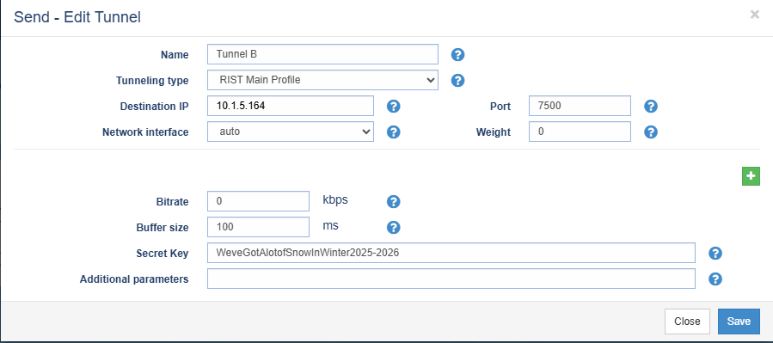
RIST configuration on IQOYA: encoding
1. RIST Tunnel declaration - Profile: Simple, Main - One or several destination IP@:ports - Eth port if multicast - If there are several destinations, give a weight to each “path” (IP link aggregation) - Total bitrate of the tunnel (several streams can flow in the tunnel) - Buffer size: 4 to 7 time the ping response time. - Secret key for encryption is used (Main profile)
2. Declare the IP streams - Stream protocol: UDP, RTP, with or without MPEG-TS encapsulation - For each stream, select the tunnel it flows through - Give an ID (virtual port) to each stream in the tunnel.
Note: Several streams can be included in the same tunnel.

Slide 11
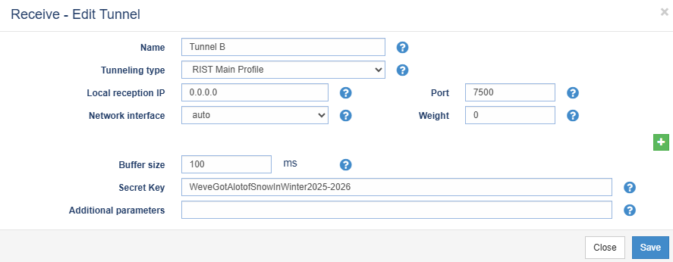
RIST configuration on IQOYA: decoding
Declare RIST tunnels: - Set the same parameter values as on the RIST encoder - One or several tunnel paths IP@:ports - Buffer size - Secret key if encryption is used
Declare the IP streams to receive: - select the tunnel it flows through. - give its ID (virtua port)

