Slide 1
IQOYA RANGE
IP audio codecs
for audio distribution & remotes over IP

Slide 2


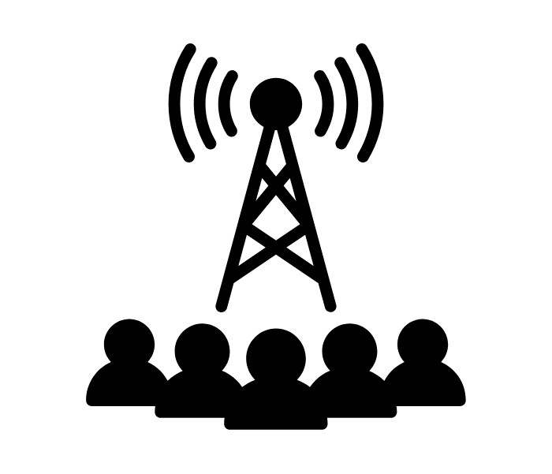


WHAT FOR?
BROADCAST
Virtual Air Traffic Control
Reliable transport of audio contents over managed and unmanaged IP networks
STL, SSL, WEB radios, DVB audio, live remotes
Radio over IP
TRANSPORTATION
DEFENSE
CORPORATE
SPORT CONTENTS
Live streaming of conferences or debates to remote listeners
Live sport events commentaries:
whip-around coverage, multi-lingual coverage

Slide 3
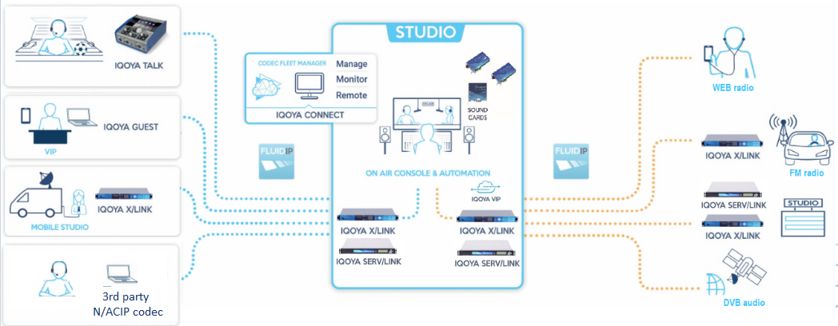
Broadcast audio workflow with IQOYA.

Slide 4




Users benefits.
All-in-one solution
Scalable & Reliable
Network security
Audio service continuity
Deliver simultaneously multiple programs to transmitter sites, other studios, DVB/cable operator, SSL/STL, Web radio CDN
Transcoding capability
Very High MTBF
Number of supported channels can be increased by software
Dual streaming, FECs
Total isolation between internal LAN audio and the internet
Redundant PSUs, 1+1 redundancy software option for SERV/LINK
2 backup levels in decoding

Slide 5
Main features.
for programs distribution
3 decoding priorities per output program (2 backup levels)
Unicast, multicast, multi-unicast, multi-multicast
Configuration / monitoring via Web interface, API, SNMP
Tunneling of auxiliary data
Multiformat encoding (PCM, G722, OPUS, MPEG …)
FECs, Dual redundant streaming
Multiprotocol streaming (UDP, RTP, MPEG TS, Icecast/shoutcast..)
Optional synchronization of decoders via NTP or Transcoding of IP streams

Slide 6
Main features.
for live remotes
3 decoding priorities per output program (2 backup levels)
Auto-redial
Compatible with any N/ACIP compliant 3rd party codec
Support of SIP, Direct SIP (Aka unregistered SIP), Symmetric RTP
FECs, Dual redundant streaming
Support of stereo and/or mono communications
Configuration and control via WEB Interface, API
Dual SIP registration
Configuration via our contribution IQOYA Connect service

Slide 7
IQOYA X/LINK
THE RANGE

Slide 8
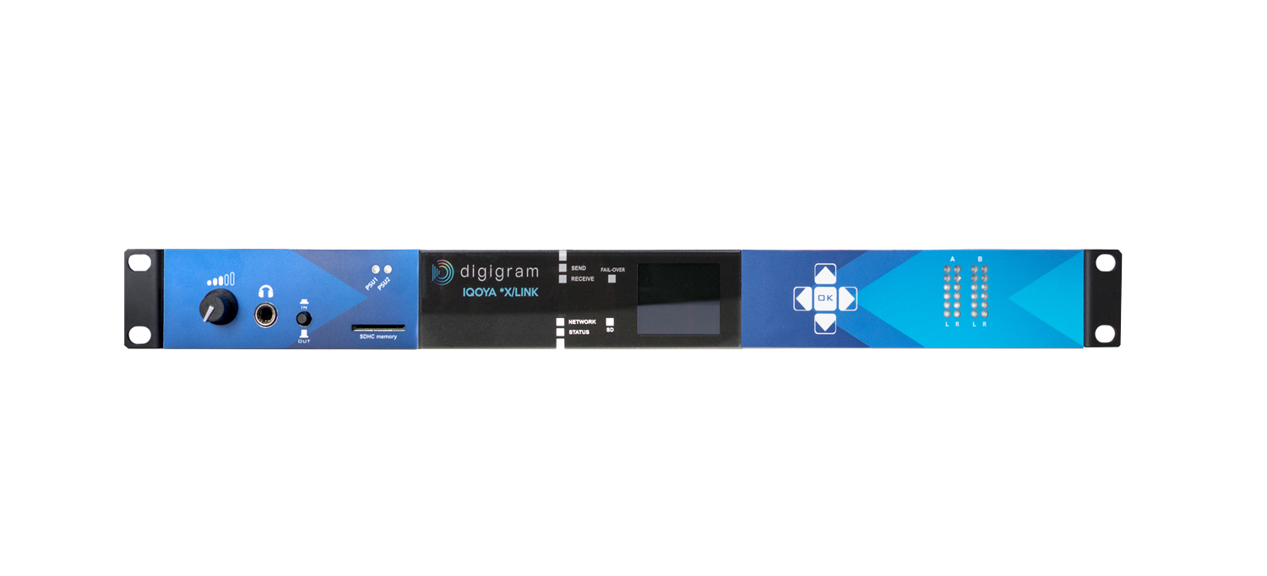
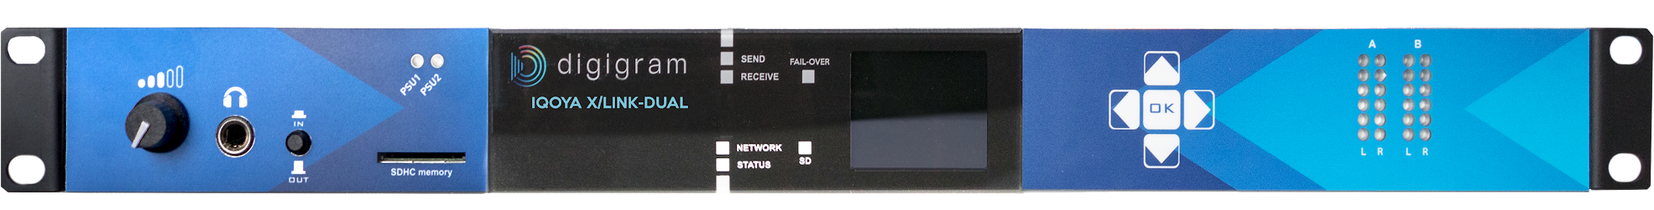

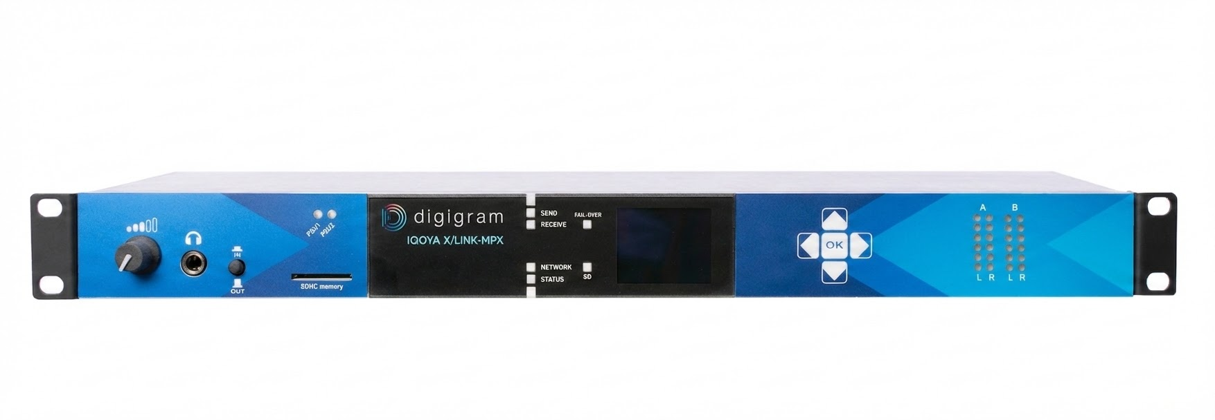
IQOYA X/LINK Range.
Number of I/O channels
2
4
6
8
10
12
14
16
AES3
AES67
X/LINK-LE
Analog
AES3
AES67
X/LINK-ST
Analog
AES3
AES67
X/LINK-DUAL
Analog
AES3
licences for additional channels
AES67
licences for additional channels
X/LINK-AES67
Analog
licences for additional channels
1 MPX
X/LINK-MPX

Slide 9
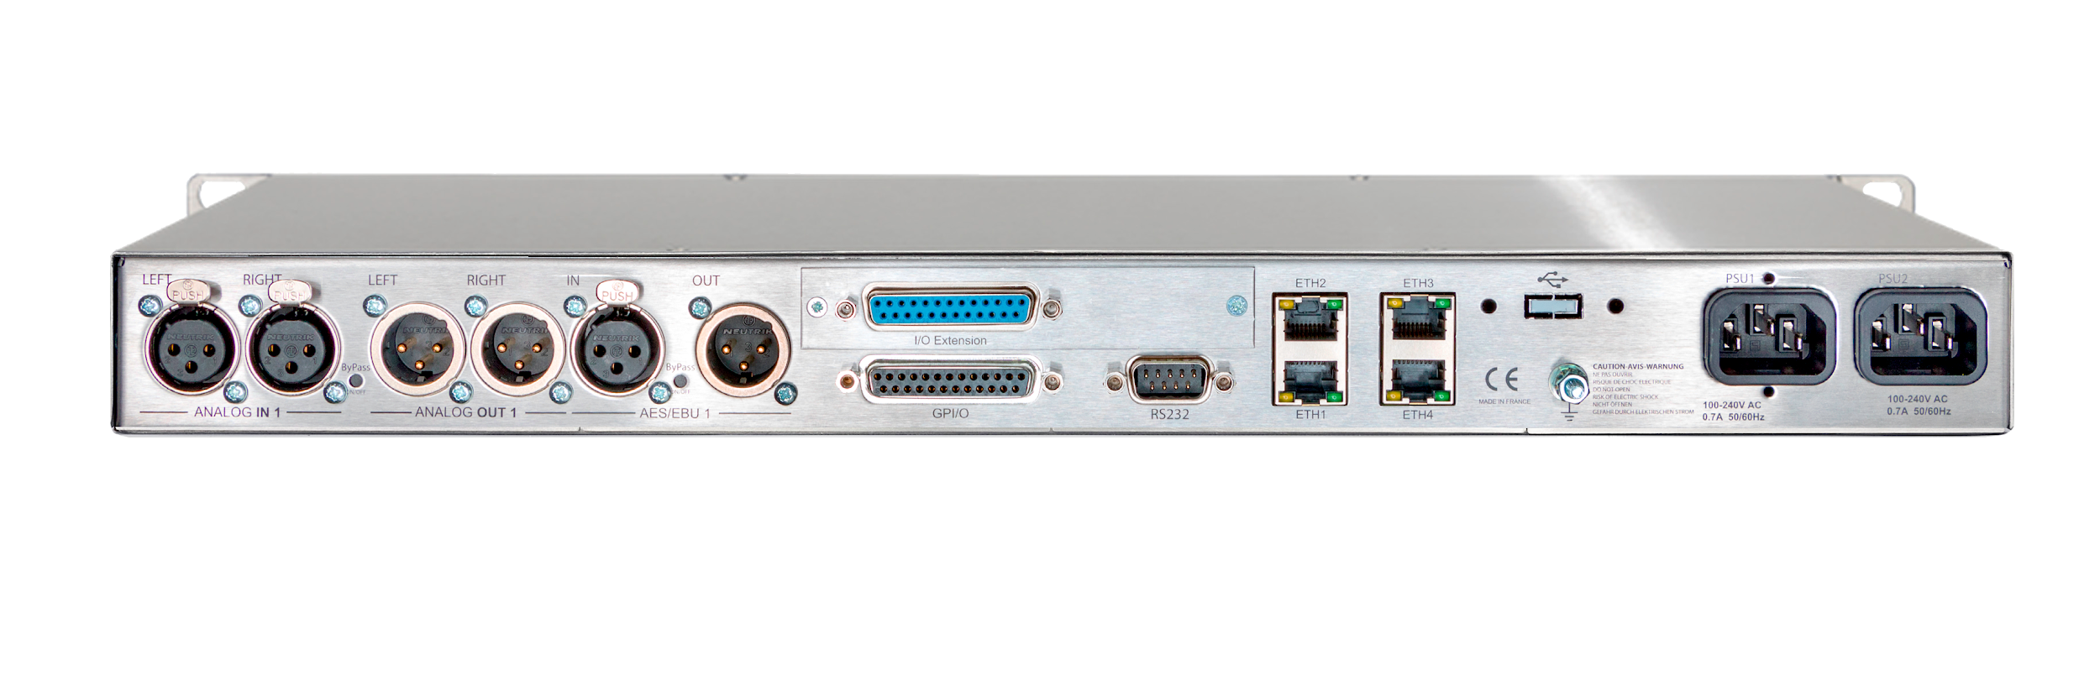
X/LINK main characteristics.
Can be use either for programs distribution or live remotes
AES3, AES67
Low consumption (~15W)
Redundant universal power supply units
Fanless
Analog +24 dBu
4 network ports for separation of IP traffics
Analog & Digital audio connectivity via XLR connectors

Slide 10
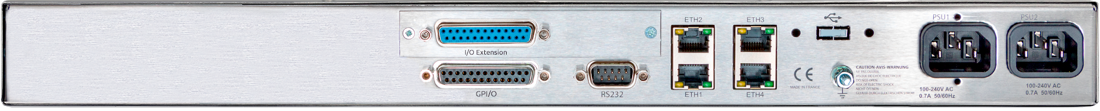
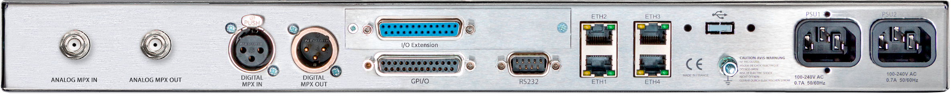
Zoom on back panels.
Analog outputs 1&2
AES3 in 1
AES3 in 1
Hardware extension depending on version*
Network ports
X/LINK-LE
X/LINK-ST
X/LINK-DUAL
Analog input 1&2
Hardware bypass analog I/Os 1&2
Hardware bypass AES3 I/O 1
GPIOs
1 to 4
Serial port
Redundant internal PSUs
GPIOs 5 to 8
Network ports
X/LINK-AES67
GPIOs 1 to 4
Serial port
Redundant internal PSUs
MPX Digital I/O
GPIOs 5 to 8
Network ports
X/LINK-MPX
MPX Analog I/O
GPIOs 1 to 4
Serial port
Redundant internal PSUs
*For X/LINK-LE or X/LINK-ST: GPIOs 5 to 8
For X/LINK-DUAL: Analog I/O 3 & 4, AES3 I/O 2

Slide 11
IQOYA SERV/LINK
THE RANGE

Slide 12
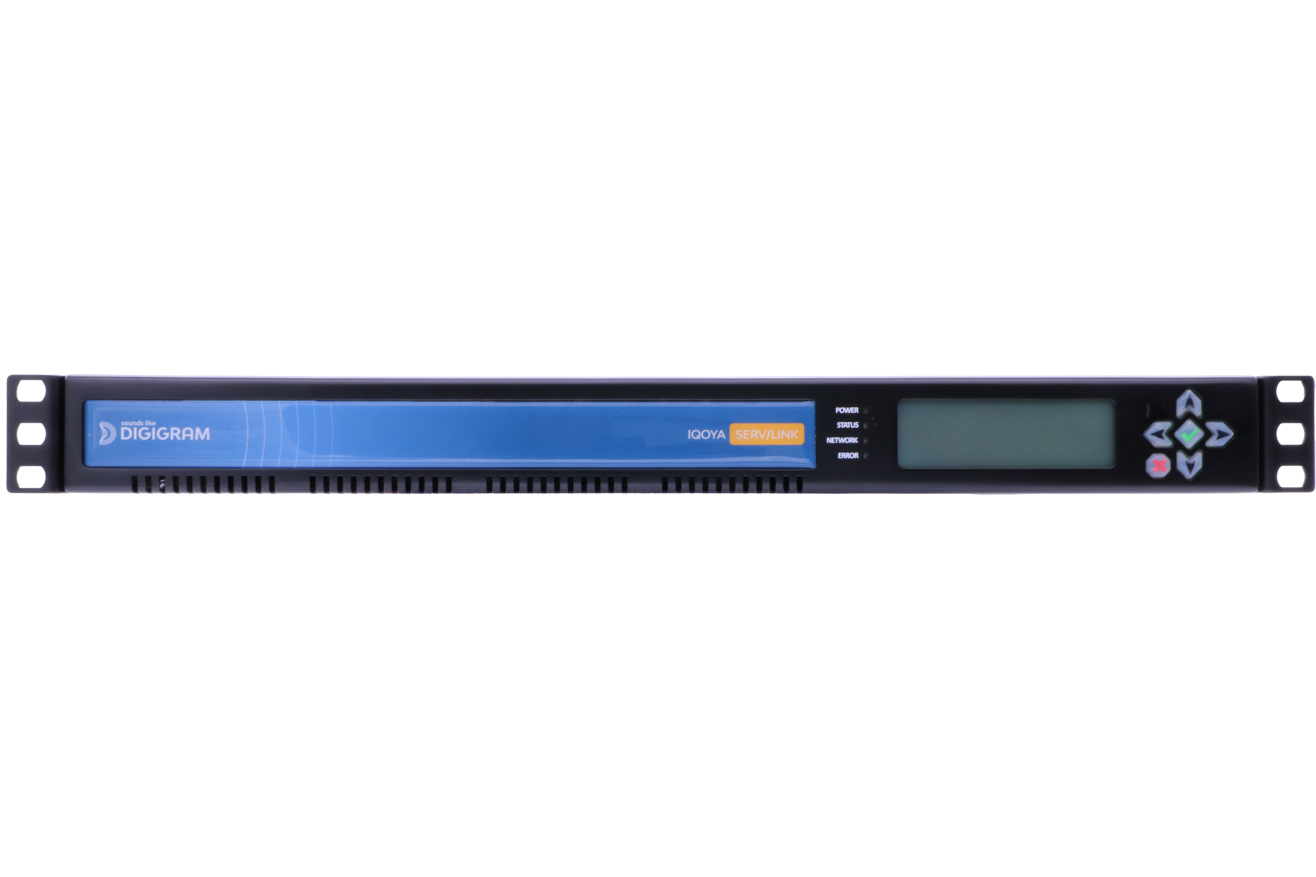
IQOYA SERV/LINK Range.
Number of I/O channels
8
16
24
32
40
48
56
64
72
80
88
96
104
112
120
128
AES3
Analog
SERV/LINK 882
AES3
SERV/LINK 16162
Analog
AES67
licences for additional channels
DANTE
licences for additional channels
SERV/LINK 88-AES67 or DANTE
AES67
licences for additional channels
SERV/LINK 7272-AES67 or DANTE
DANTE
licences for additional channels
TC
licences for additional channels
SERV/LINK 88-TC

Slide 13
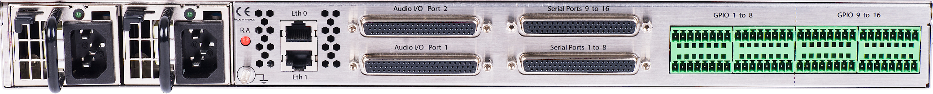
SERV/LINK main characteristics.
Can be use either for programs distribution or live remotes
2 network ports for WAN streaming and/or control
From 8 to 128 audio I/Os, depending on audio connectivity
1U Rack
Optional GPIOs
2 hot swappable redundant universal power supply units
Analog and AES3 audio connectivity via XLR connectors on breakout cables
Additional network ports for local AoIP channels

Slide 14
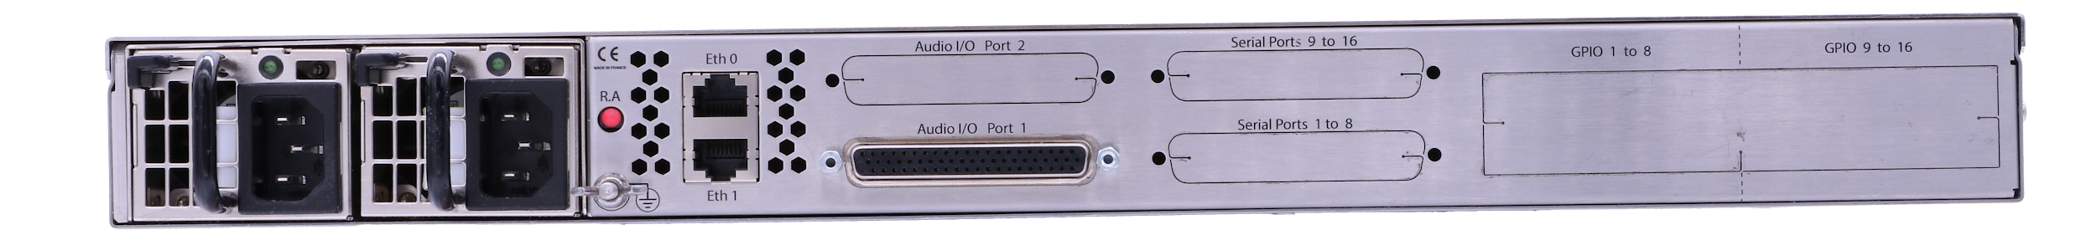
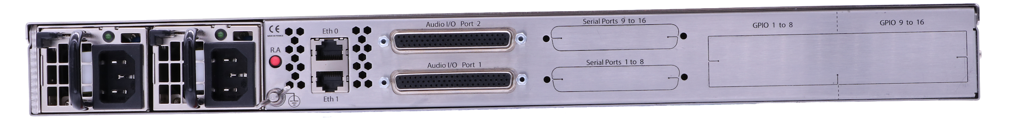
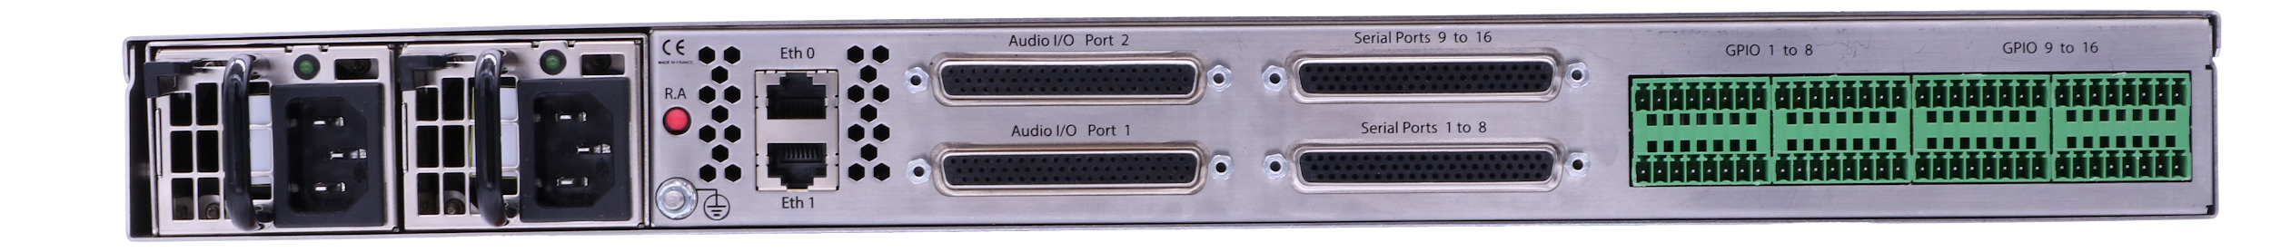
Zoom on back panels.
2 RJ-45
10/100/1000 Ethernet
Optional serial ports
SERV/LINK 882
Hot-swappable redundant PSU
Reset PSU alarm
Audio I/Os
SERV/LINK 16162
Optional serial ports
SERV/LINK Hardware options
GPIOs

Slide 15
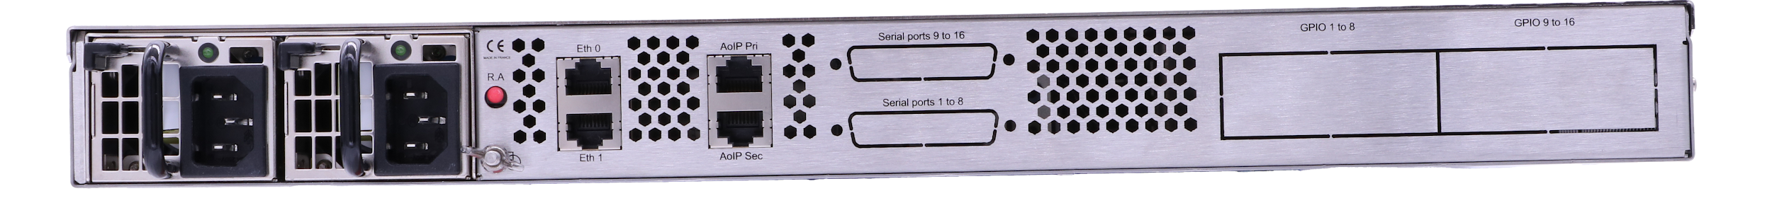

Zoom on back panels.
2 RJ45 ports for streaming and/or control
Optional serial ports
SERV/LINK-AES67 or -DANTE
Hot-swappable redundant PSU
Reset PSU alarm
2 RJ45 AES67 or DANTE
Optional GPIOs
SERV/LINK-TC

Slide 16
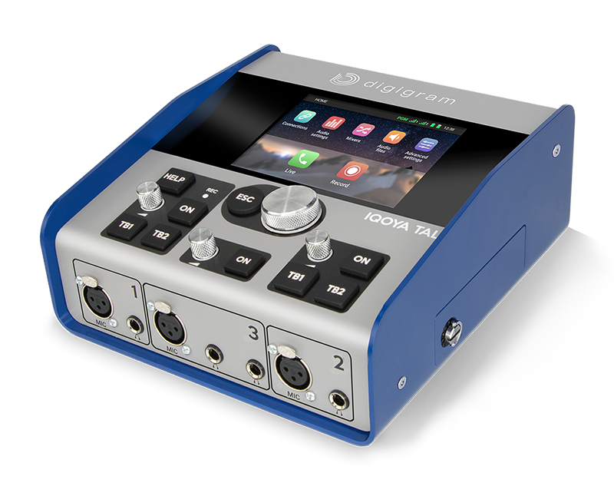
IQOYA TALK
Simply Powerful

Slide 17
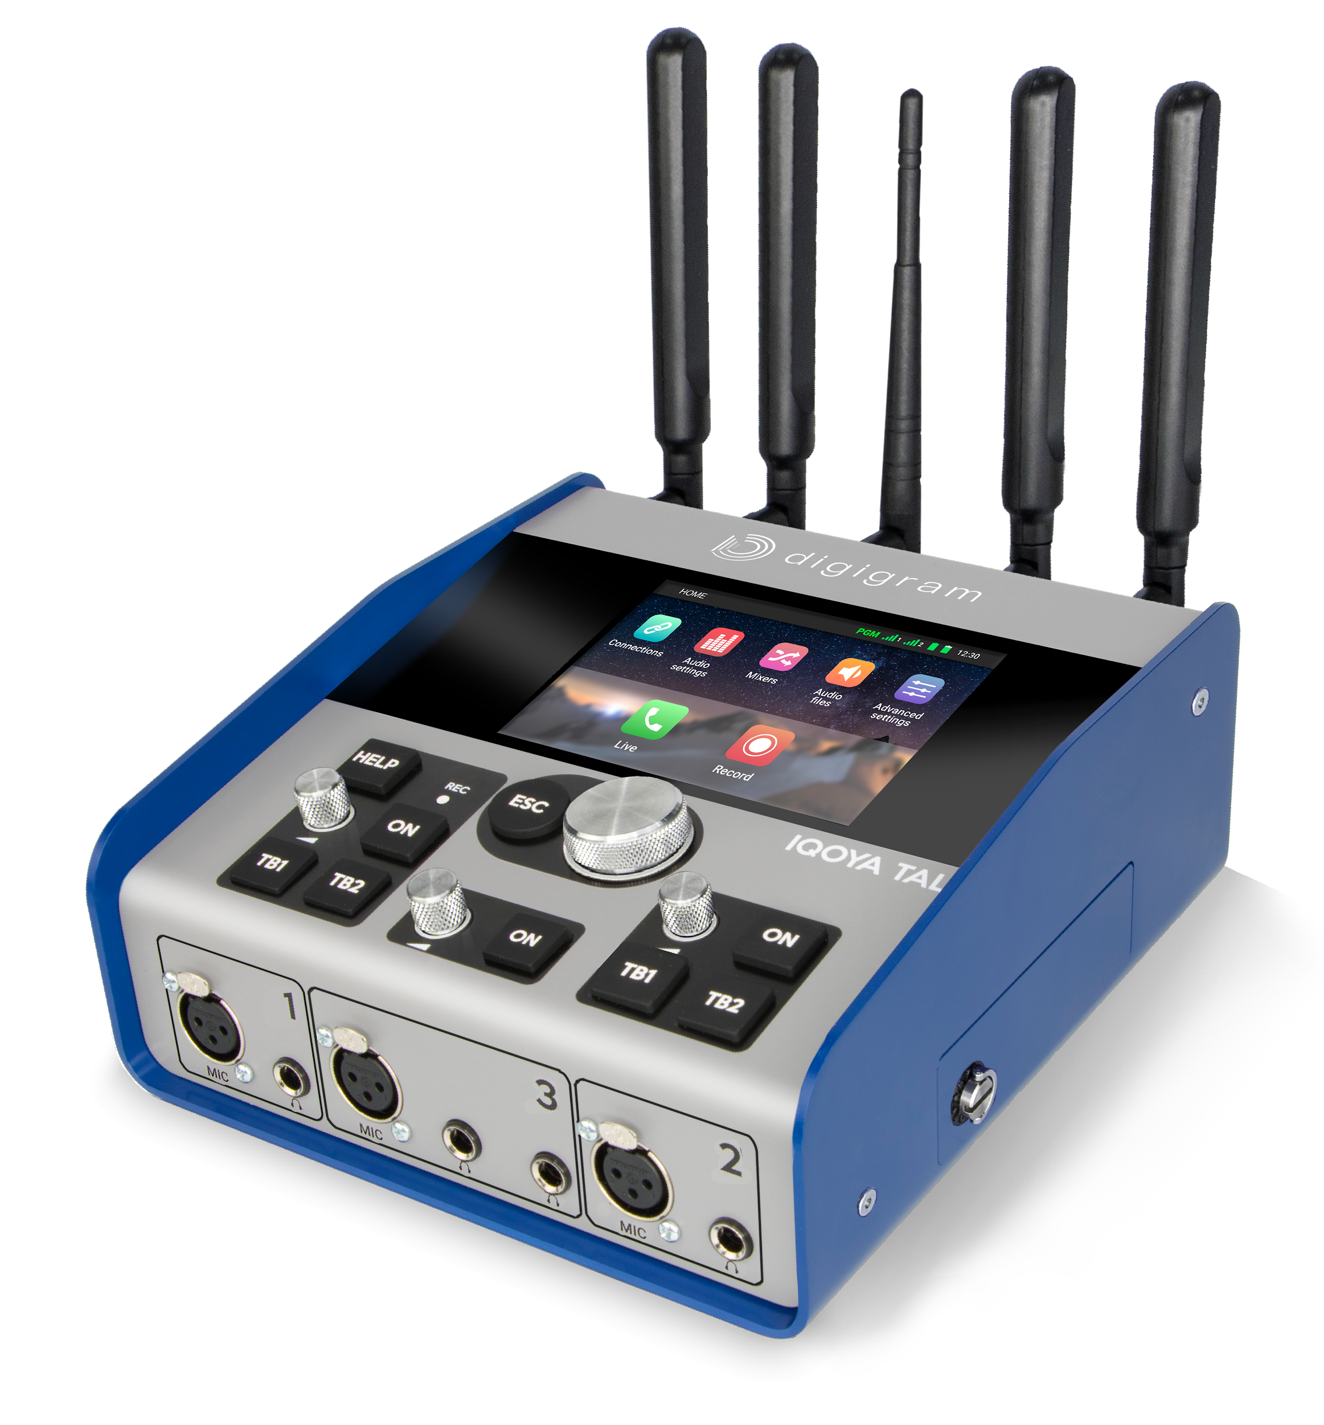
TALK main characteristics.
Dedicated to live remote broadcasting for Radio & TV
Portable IP audio codec
Large number of built-in
connectivities: 2 Ethernet,
WiFi, 2x 3G/LTE/4G
Intuitive interface
Up to 4 journalists and guests
Key actions available in 2 clics
2 independent SIP connections TB & PGM
High quality
audio recorder
2 hot-swappable
batteries
Up to 8 hours autonomy
11 inputs / 10 outputs mixer

Slide 18
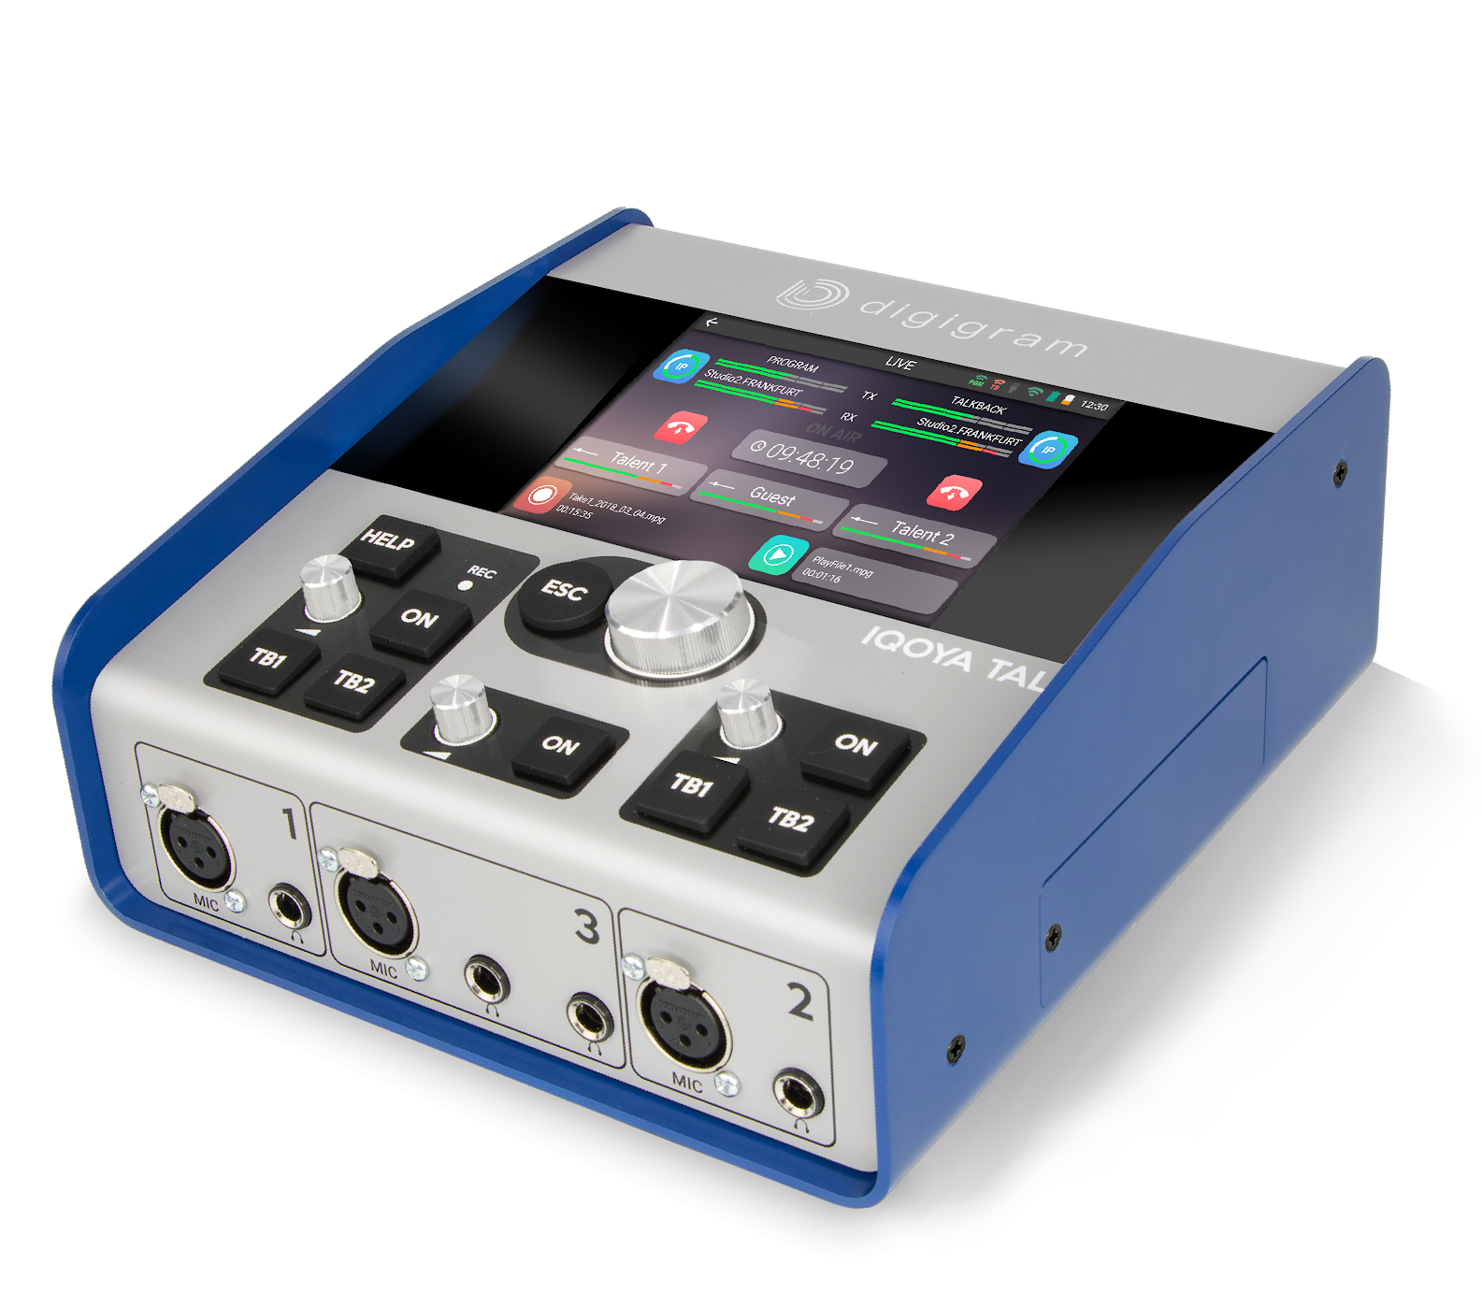
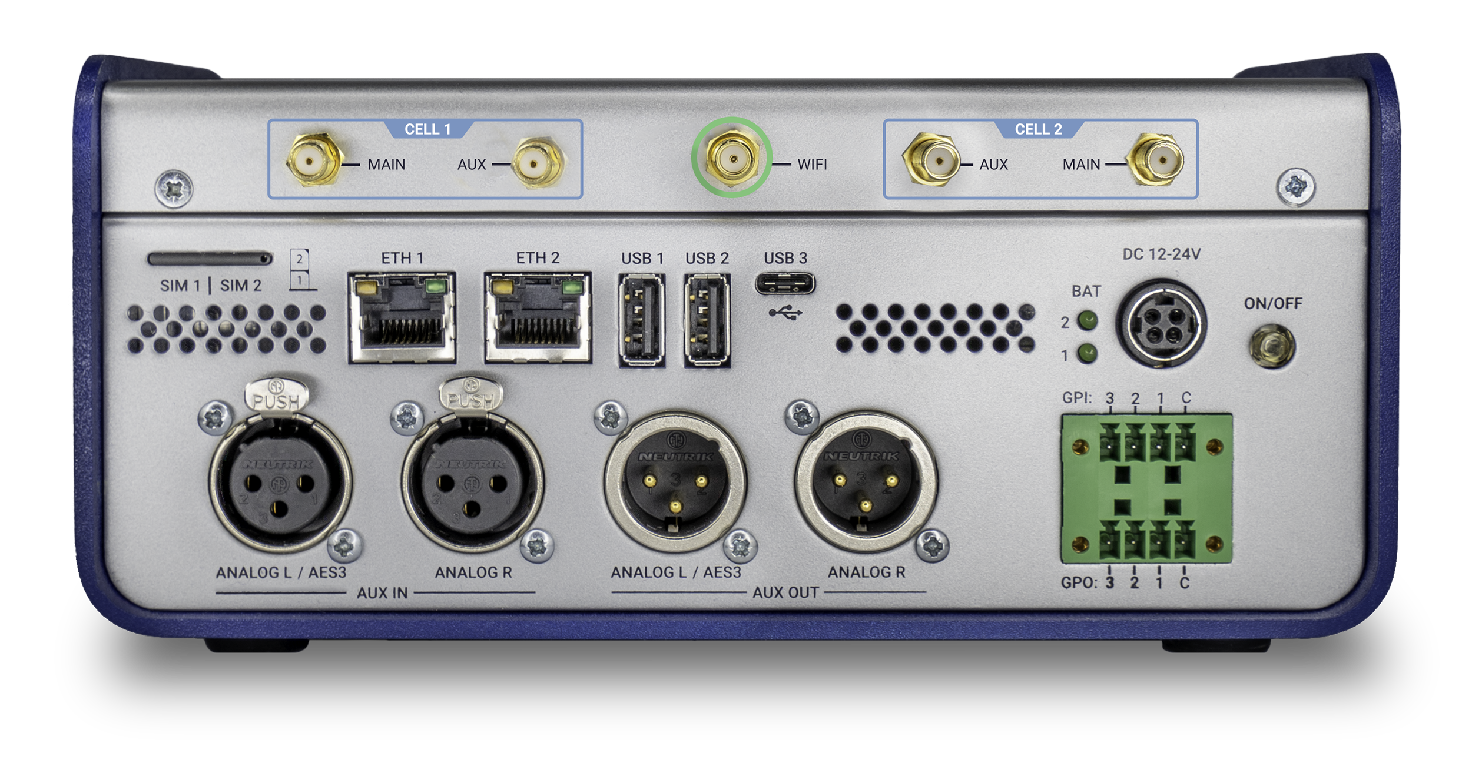
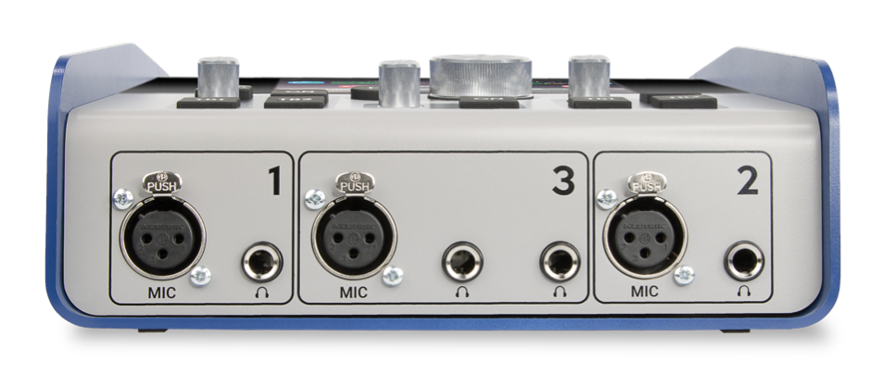
Zoom on Hardware features.
5” touch screen
Navigation control knob
Record indicator
ON AIR buttons
Talkback buttons
4G/LTE antenna
USB-A
& USB-C
Wifi Antenna
4G/LTE antenna
12/24 VDC power supply
Gain control knob
SIM tray
RJ45 Eth ports
Power button
Balanced Analog/AES stereo inputs
Balanced Analog/AES stereo outputs
3 GPIOs
3 Mic/line inputs
4 Headphone outputs

Slide 19
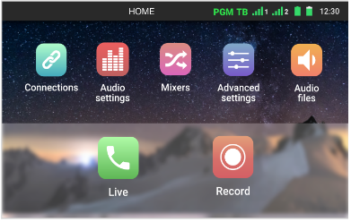
Zoom on software features.
Mixers
select the program streamers to the studio
select the monitoring on each headphone output (1, 2, 3)
select the auxiliary output
Mix the inputs channels to the headphone outputs or mix the Tx content with the studio returned content and the talkback channels
Home page
Status bar
Live
Select the destination codec / audio profile
Place / accept calls
Turn recording On / Off
Online or offline recording
online: Program output contents is recorded
offline: A mix of the mix inputs is recorded
record or stop the mix in WAV format defined in the mixer for the program Tx
play / stop an audio file from the playlist
mic input gain setting
Icons to access each category of parameters

Slide 20
IQOYA CONNECT
Connection service

Slide 21

A Connection Service.
Responsible for establishing broadcast quality communications between IP codecs through the internet and our audio over IP infrastructure.
Live remote broadcasting solutions for:
Radio and TV Broadcasters
Live program distributors
Live production companies
Notes:
Secure connection between codecs = SBC in the infrastructure

Slide 22


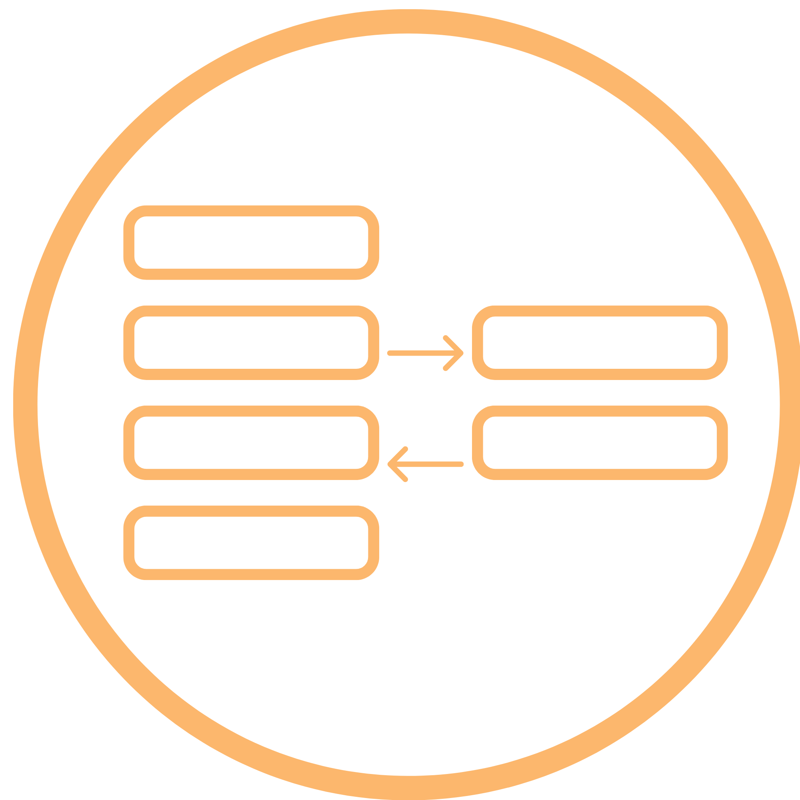


A Web Platform
Manage users and assign roles
Create contacts
Provision Digigram field codec configurations for journalists
Configure Digigram studio codec
Manage communication links for guests
View and manage the codec fleet
Monitor the status of codecs and communications in real time
Take full remote control of IQOYA TALK field codecs
View network metrics of ongoing and past communications

Slide 23
Users benefits.
For technician
For journalists
For broadcasters
Prepare the settings of remote live broadcast sessions in advance and avoid the last minutes pressure
No need to pre-configure IQOYA TALK units and assign them to journalists
Real time monitoring of the communications status, and act from anywhere
Don’t struggle with unreliable communications
Inviting guest is a breeze
Intuitive web interface
No codec configuration to be done
  Journalists can focus on their job!
  Personal settings for the mixes to the headphones
Never alone on the field
  Journalists can request for remote assistance
  Technicians can remotely configure the audio settings
Cut costs:
  IQOYA TALK units shared by all the journalists
  No need to send a technician with the journalist at each remote broadcast location.
  No need to design, install and maintain your own audio over IP infrastructure.
Flexibility regarding remote broadcasts management
Safe and secure, audio stream sources are authenticated: you control what goes on air.

Slide 24
Example of
Uses cases

Slide 25




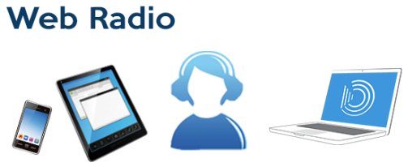

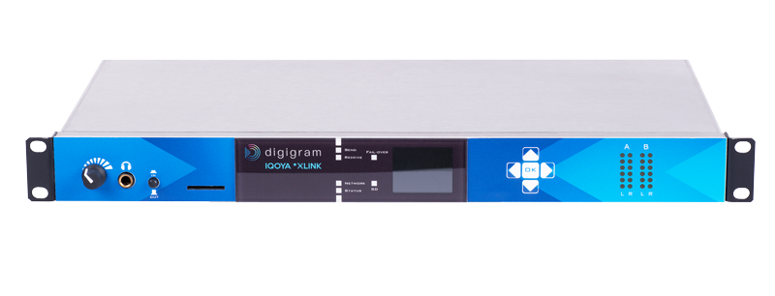


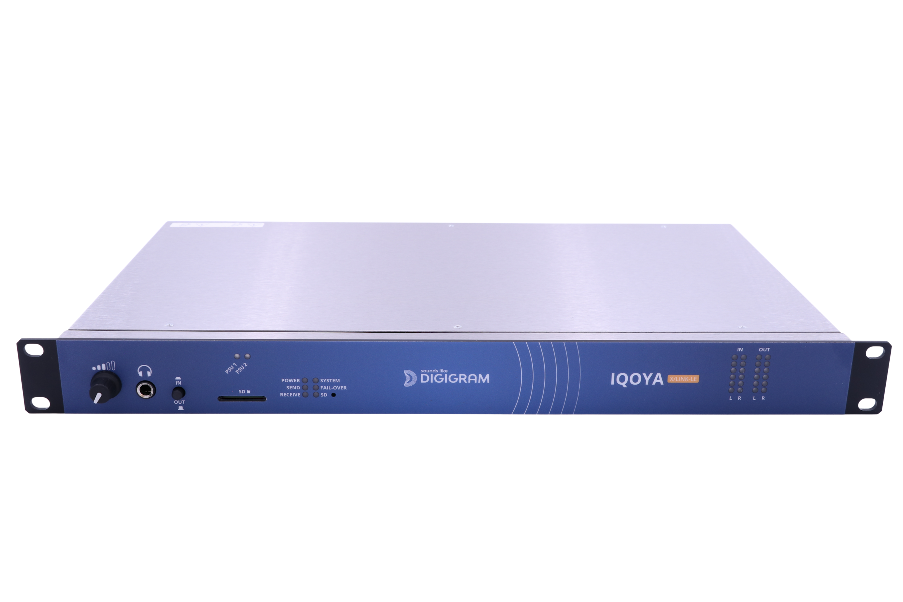
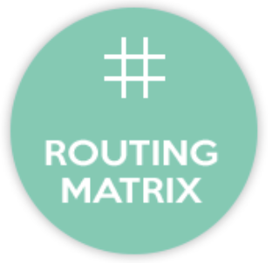
Audio distribution general use case.
WAN
Web radio
Multi protocols
Multi formats
Optional transcoding
Radio Studio
AES67, RAVENNA
Icecast,
Shoutcast,
HLS multi bitrate,
LAN
On-Air console
MPEG-TS
SPTS, MPTS
AES/EBU or analog
ACIP
Dual streaming

Slide 26


IP Backup to satellite.
Transmitter Site
Radio Studio
Satellite IRD
WAN
Analog or AES/EBU
RDS data on RS232 or UDP
IQOYA Decoding priorities
Priority 1: satellite decoder output (analog or AES/EBU) with silence detection enabled
Priority 2: IP stream from studio
Priority 3: Sound file or playlist on SDHC card
Hardware by-pass on power failure enabled -> satellite program is routed to the transmitter

Slide 27

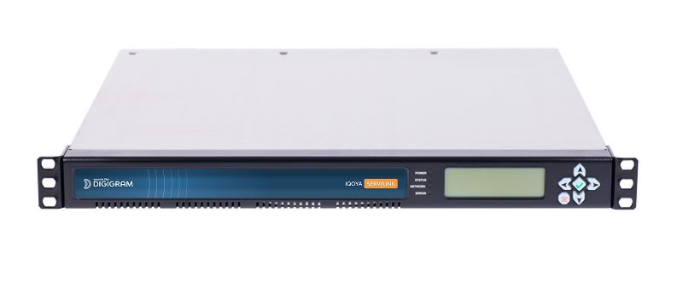
Streaming to DVB/cable operator.
Studio
WAN MPLS
DVB cable operator
Multiple Studios
Mux
WAN MPLS
Multiple MPEG-TS/IP SPTS or MPEG-TS MPTS

Slide 28
Audio via DVB (RCF FR).
> 40 regional studios
Data center
IQOYA SERV/LINK A
VPN MPLS & internet
Life line (IP)
MPEG-TS MPTS / IP
IP RTP stream mono with FEC
Globecast MUX
IQOYA SERV/LINK B
40+ programs to stream in multiple bitrates via DVB
Transcoding of 40+ regional programs (RTP MPEG L2 to MPEG-TS MPTS AAC)
1+1 redundancy

Slide 29


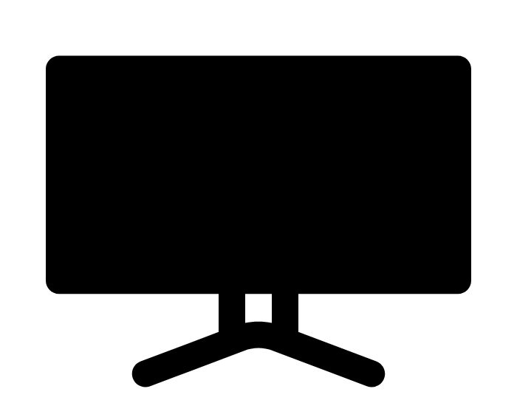
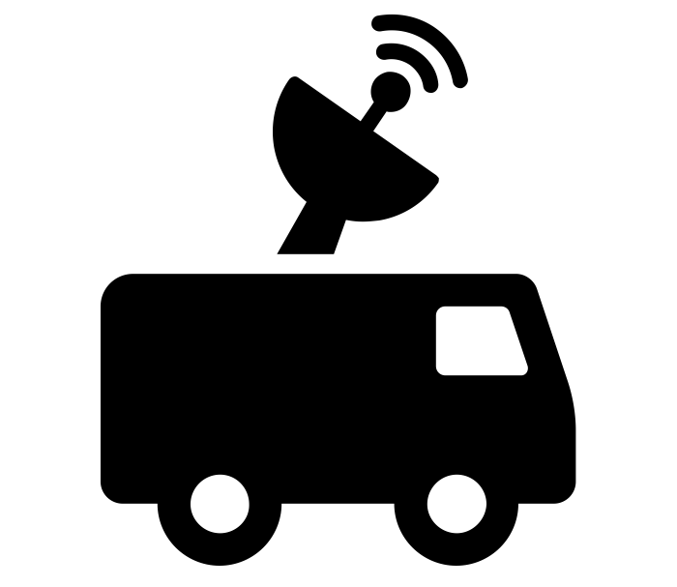
Live remote commentaries for sports.
Warner Bros. Discovery Eurosport
Language 1
remote commentator
DATA CENTER
TV
Language 2
remote commentator
12 SERV/LINK units, AES67 connectivity, 8 to 64 stereo channels
IQOYA connect for about 300 simultaneous contributions
At the production studio, all the commentaries in different languages are embedded with the clean feed in a TS stream for delivery to TV stations.
Used for many sport competitions (world championships, olympic games, etc...)
Language N
remote commentator

Slide 30
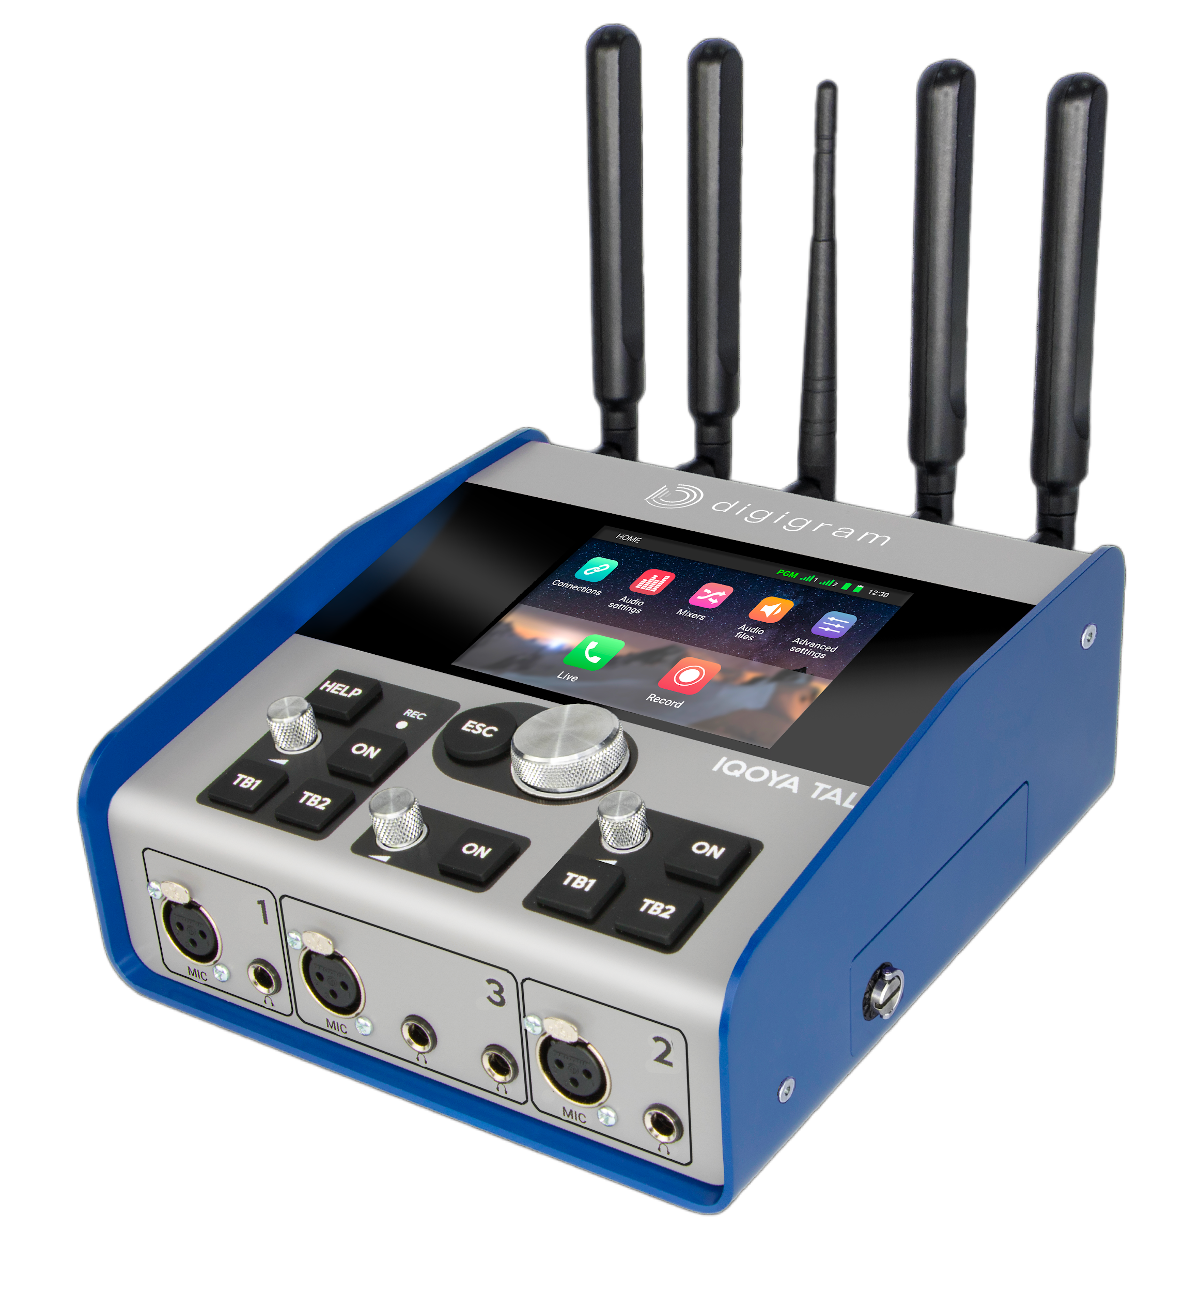
Live remote commentaries for sports.
Using IQOYA TALK
MASTER CONTROL ROOM
Language 1
remote commentator
ST2110 LAN
TV
Language 2
remote commentator
Language N
remote commentator

Slide 31



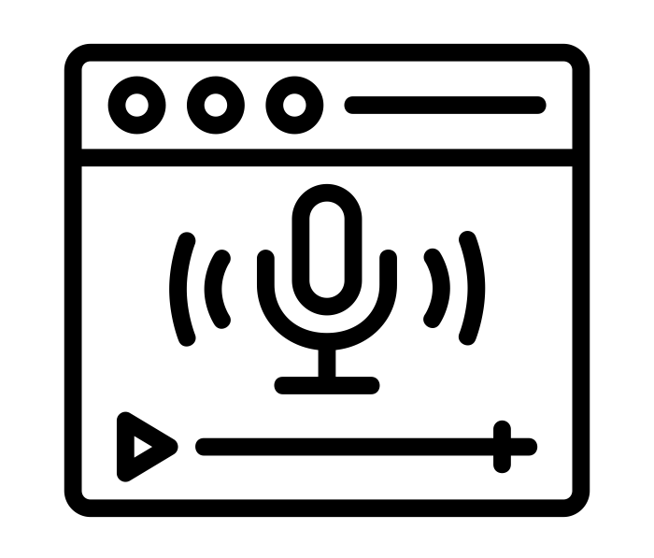
Live streaming of conferences.
ONU
Conference Room 1
Language 1
Internal multicast IP network
Language N
Internal
listeners
Conference Room 2
Language 1
TECHNICAL ROOM
DANTE
Language N
Distribution
Web radio
Conference Room 3
Language 1
Language N
External
listeners

Slide 32
Thank you!

