Slide 1


ALP-X Range
Sound cards

Slide 2

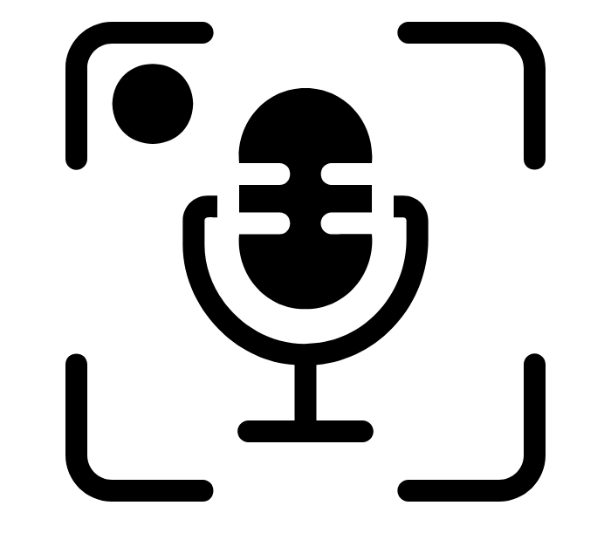


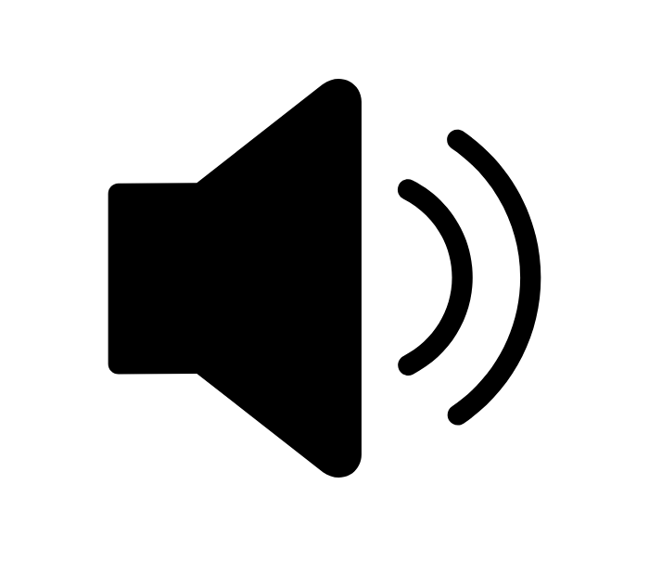

Applications.
BROADCAST
SAFETY SERVICES
CRITICAL
Recording system for radio comms
Acquisition / playout of audio signals on workstations & servers
Radio automation & Multichannel audio recording and playout
Audio interface with Mic inputs in dispatch consoles
Live and pre-recorded announces
Effects processors for immersive audio applications
Surveillance of audio signals from process
TRANSPORTATION
ENTERTAINMENT
INDUSTRY

Slide 3





Made for mission-critical applications.
Rock-solid & Life-long
Hiccup free reliability
Seamless integration
Pristine sound quality
Compactness

Slide 4
The range.
Network Audio Cards - AoIP
References |  | Protocol | AoIP I/Os
ALP-DANTE | ALP-DANTE-LE | DANTE | 64/64
ALP-AES67-64 |  | AES67 - RAVENNA - ST2110-30 | 64/64
ALP-AES67-128 |  |  | 128/128
Analog &/or Digital Audio Cards
Reference |  | Analog Mono I/Os | AES3 Mono I/Os | GPI / GPO
ALP222e | ALP222e-Mic | 2/2 | 2/2 | 2 / 2
ALP280e | ALP280e-Mic | 8/2 | - | 8 / 8
ALP442e | ALP442e-Mic | 4/4 | 4/4 | 8 / 8
ALP881e |  | - | 8/8 | 8 / 8
ALP882e | ALP882e-Mic | 8/8 | 8/8 | 8 / 8

Slide 5
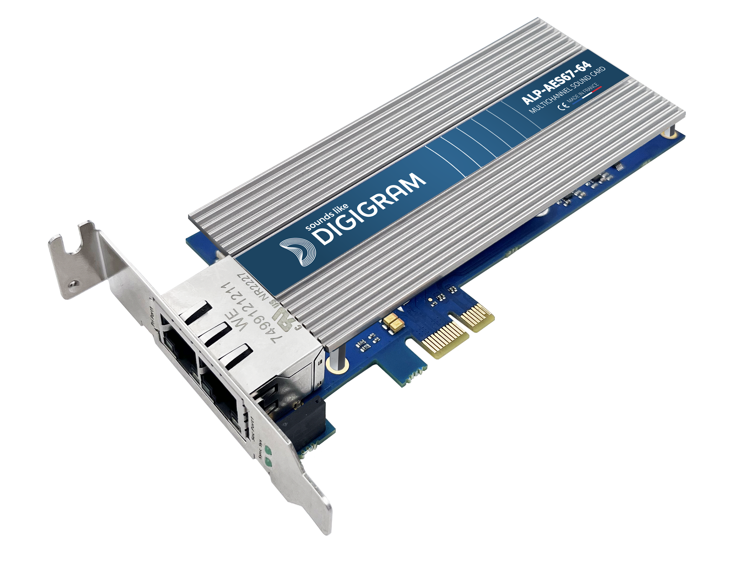
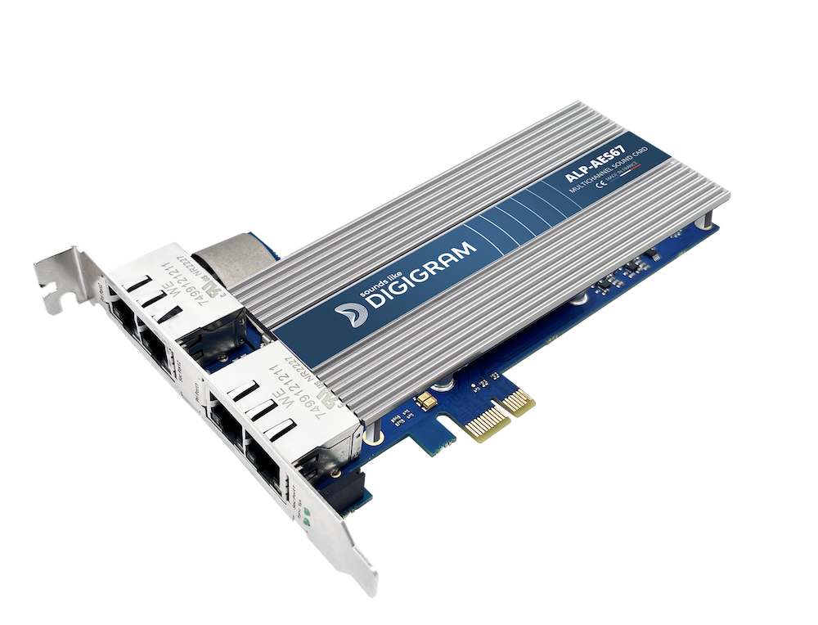
Seamless integration is key.
Low profile PCI Express™ x1
(x2, x4, x8, x16 compatible)
Fanless design
Compatible Windows or Linux
APIs for integration into third party software applications
Low profile
Full-height profile

Slide 6


Supported OS.
Multicard and multiclient drivers for Windows and Linux
Intuitive app for the management of cards parameters: ALP-X Manager
From Windows 10 & Windows Server 2019
APIs: Wasapi/Directsound, ASIO
ASIO Control panel
Ubuntu 20 & 22 & 23, Debian 10 & 11, CentOS 9
APIs: Alsa, Libgpio for GPIOs
Full control of the I/O settings and low latency embedded mixer* via Alsa controls (*except for AoIP cards)

Slide 7
ANALOG & DIGITAL AUDIO ALP CARDS
Notes:
On top of the broadcast applications we just discussed, our sound cards are also used in other critical audio applications,
including military, aeronautical, maritime, civil defence, disaster recovery, and many more.
We have selected a few real life customer applications, but please note the use of our interfaces are limitless.

Slide 8
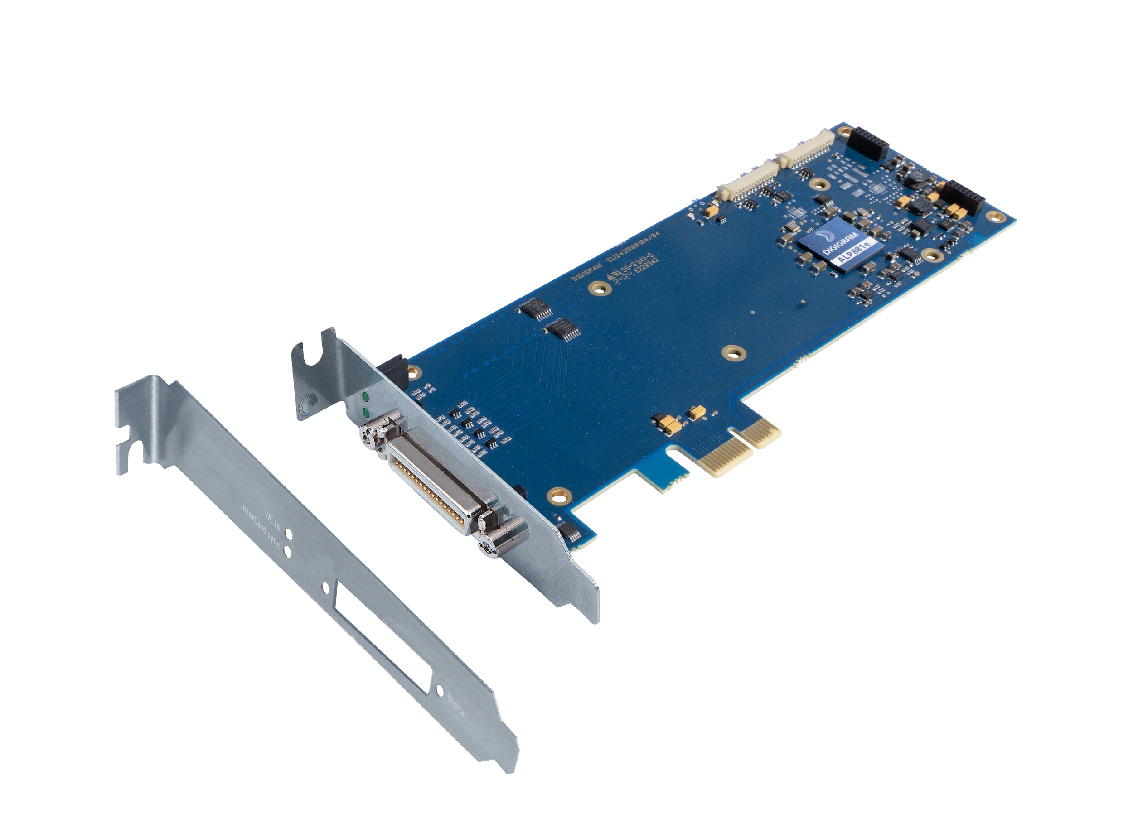
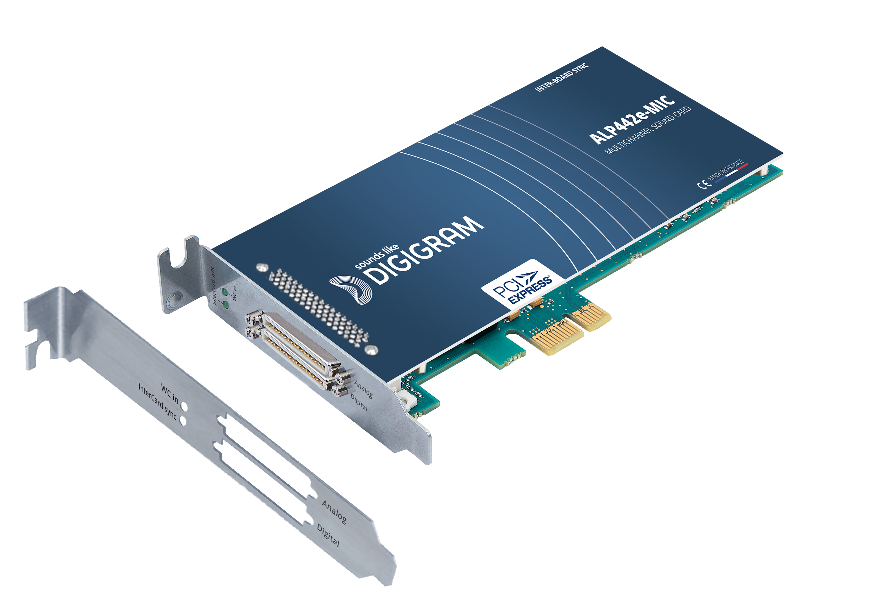

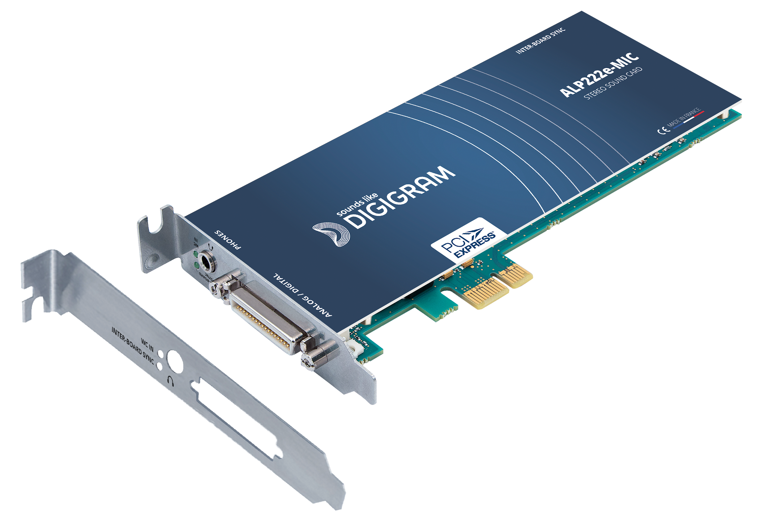
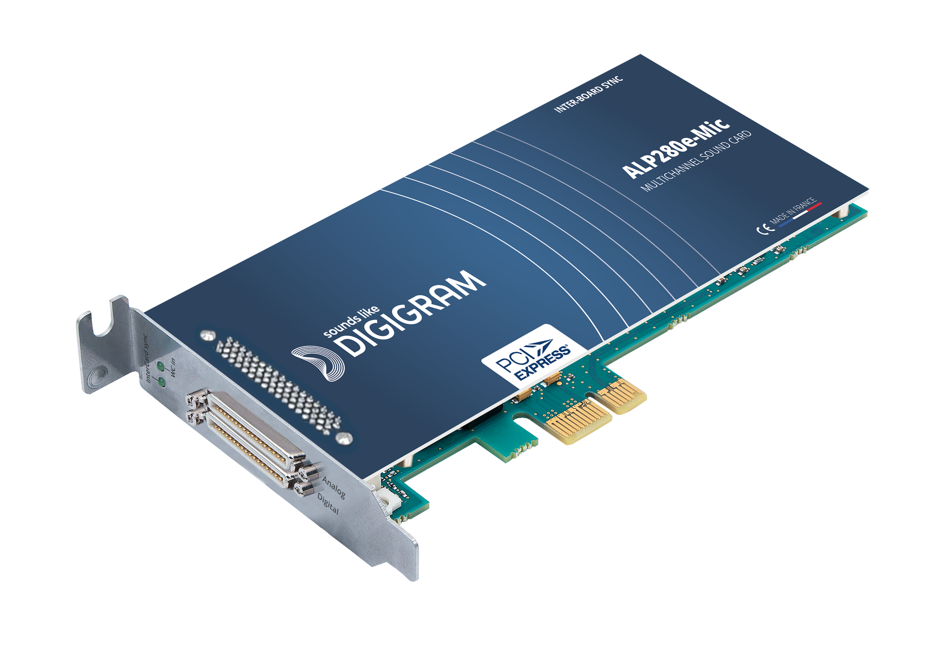
A comprehensive range.
ALP222e
ALP222e-MIC
ALP280e
ALP280e-MIC
ALP442e
ALP442e-MIC
ALP881e
ALP882e
ALP882e-MIC
SOFTWARE FEATURES Playback and recording on all the analog and digital I/Os Adjustment of input and output gains Switch for 48V phantom power Clock source selection: internal, Wordclock, AES11 Fully configurable onboard mixer GPIs status reading and GPOs status writing Up to 8 ALP cards per PC PCM 16, 24 or 32 bit sample format
HARDWARE FEATURES Balanced audio I/Os Analog line inputs and outputs maximum level +24 dBu Mic inputs gains: +65 dB (ALP222e-MIC)/ +56 dB one other -MIC cards 48V phantom power Support frequencies: 8*, 16*, 24*, 32, 44.1, 48, 88.2, 96, 176.4, 192 kHz High quality hardware sample rate converter on each AES3 input Onboard GPIs/GPOs Breakout cable(s)
*except ALP881e

Slide 9
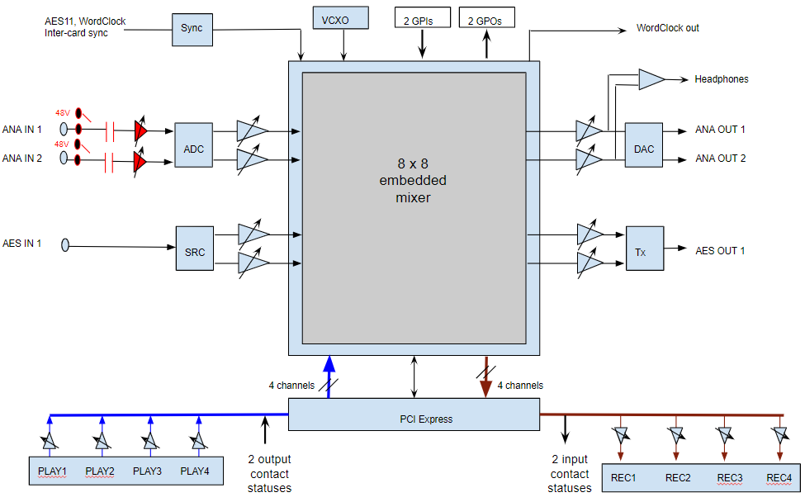
Principle.
ALP222e-MIC only
Diagram for ALP222e / ALP222e-MIC
Notes:
The card feature an embedded mixer,which accepts:
- as inputs: analog and AES3 channels, playback channels
- as output: analog and AES3 channels, recording channels
The mixer allows to

Slide 10
Recap of main characteristics
 | ALP222e / ALP222e-Mic | ALP442e / ALP442e-Mic | ALP280e / ALP280e-Mic | ALP882e / ALP882e-Mic | ALP881e
Analog i/o mono channels | 2 / 2 | 4 / 4 | 8 / 2 | 8 / 8 | -
AES3 i/o mono channels | 2 / 2 | 4 / 4 | - | 8 / 8 | 8 / 8
Playback / recording channels | 4 / 4 | 8 / 8 | 8 / 8 | 16 / 16 | 8 / 8
Low latency mixer | 8x8 | 16x16 | 16 x 10 | 32x32 | 16x16
Hardware SRC | On each stereo AES3 input |  | - | On each stereo AES3 input
Switchable Mic/Line level & 48V | 2 (ALP222e-Mic) | 4 (ALP442e-Mic) |  | 8 (ALP882e-Mic) | -
GPIs / GPOs | 2 / 2 | 8 / 8 | 8 / 8 | 8 / 8 | 8 / 8
Breakout cables | 1 | 1 for analog I/Os 1 for clocks, GPIOs & I/Os | 1 for analog I/Os 1 for clocks & GPIOs | 1 for analog I/Os 1 for clocks, GPIOs & I/Os | 1 for clocks, GPIOs & I/Os
External clocks: Wordclock, AES11, intercard synchro cable
Notes:
AES3 = signal audio numérique
AES11 : synchro d’horloge numérique
SRC converter : remet chaque echantillon a la bonne cadence définie sans perdre en qualité
Phantom power : fourni l’energie vitale aux micros statiques - eviter les parasites de bruits - tension continue

Slide 11
NETWORK AUDIO CARDS - AoIP
Give your DAW reliable AoIP connectivity!
Notes:
On top of the broadcast applications we just discussed, our sound cards are also used in other critical audio applications,
including military, aeronautical, maritime, civil defence, disaster recovery, and many more.
We have selected a few real life customer applications, but please note the use of our interfaces are limitless.

Slide 12

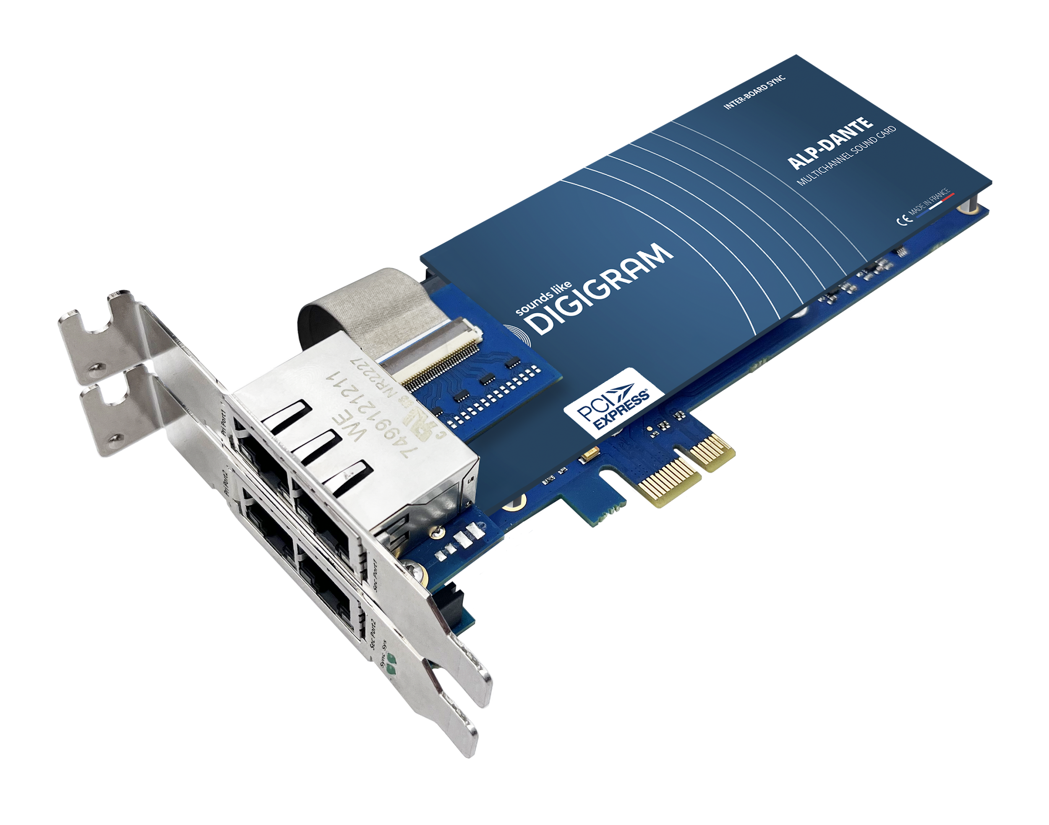
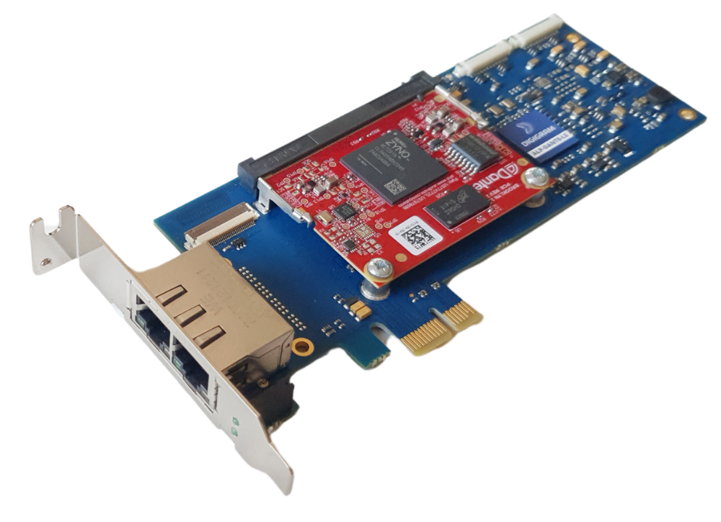
A solution to all your AoIP integration.
ALP-AES67-64
ALP-AES67-128
ALP-DANTE
ALP-DANTE-LE
SOFTWARE FEATURES Simultaneous playback and recording PTP follower or leader, PTP Grand Master Up to 8 ALP cards per PC PCM 16, 24 or 32 bit sample format (44.1/48 kHz, 88.2/96 kHz, 176.4/192 kHz)
HARDWARE FEATURES 2 or 4 RJ-45 Gbit Eth ports (except DANTE-LE)

Slide 13
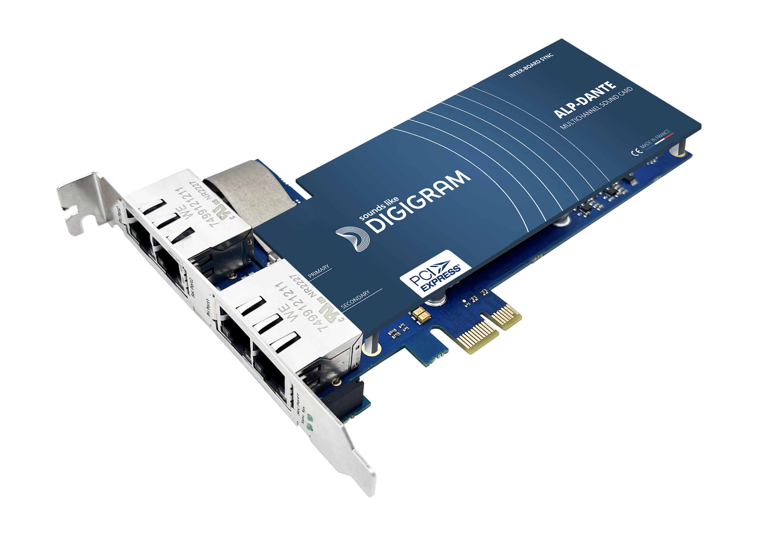

ALP-DANTE.
Cards compliant with Dante technology
FEATURES
64 input channels / 64 output channels
up to 32 input and output flows
Support for redundancy mode and switch mode
Support for AES67 compatibility (w/o redundancy & OoB)
Stream management via the Audinate Dante Controller application
Available in 2 versions:
ALP-DANTE: configurable in 2 or 4 Ethernet ports
ALP-DANTE-LE: 2 Ethernet ports, without protective faceplate

Slide 14
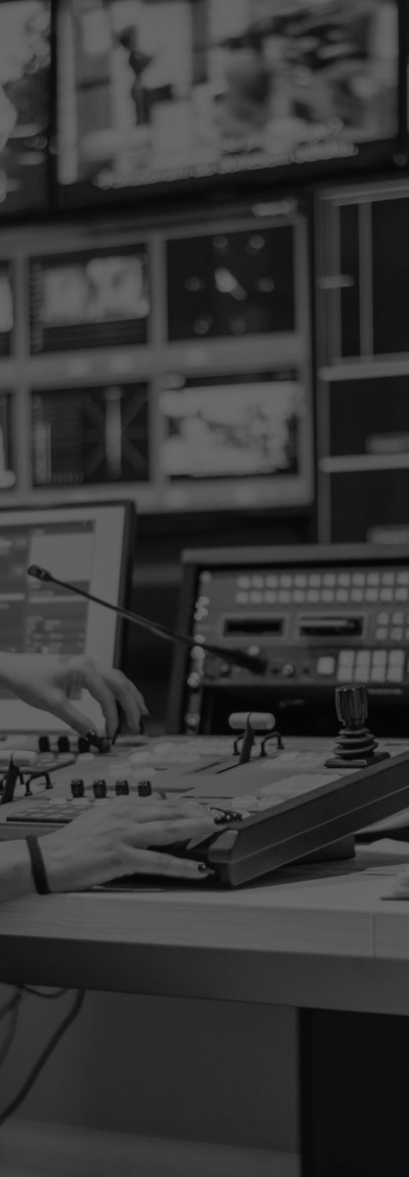
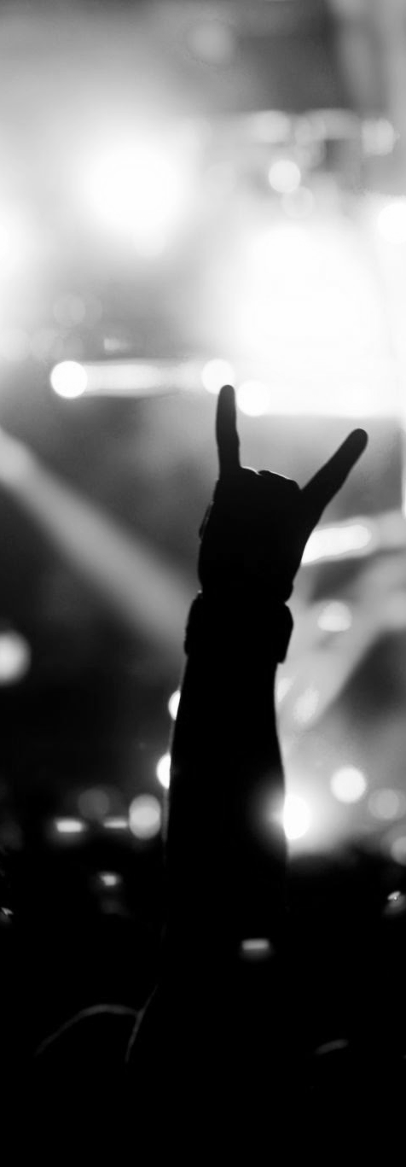
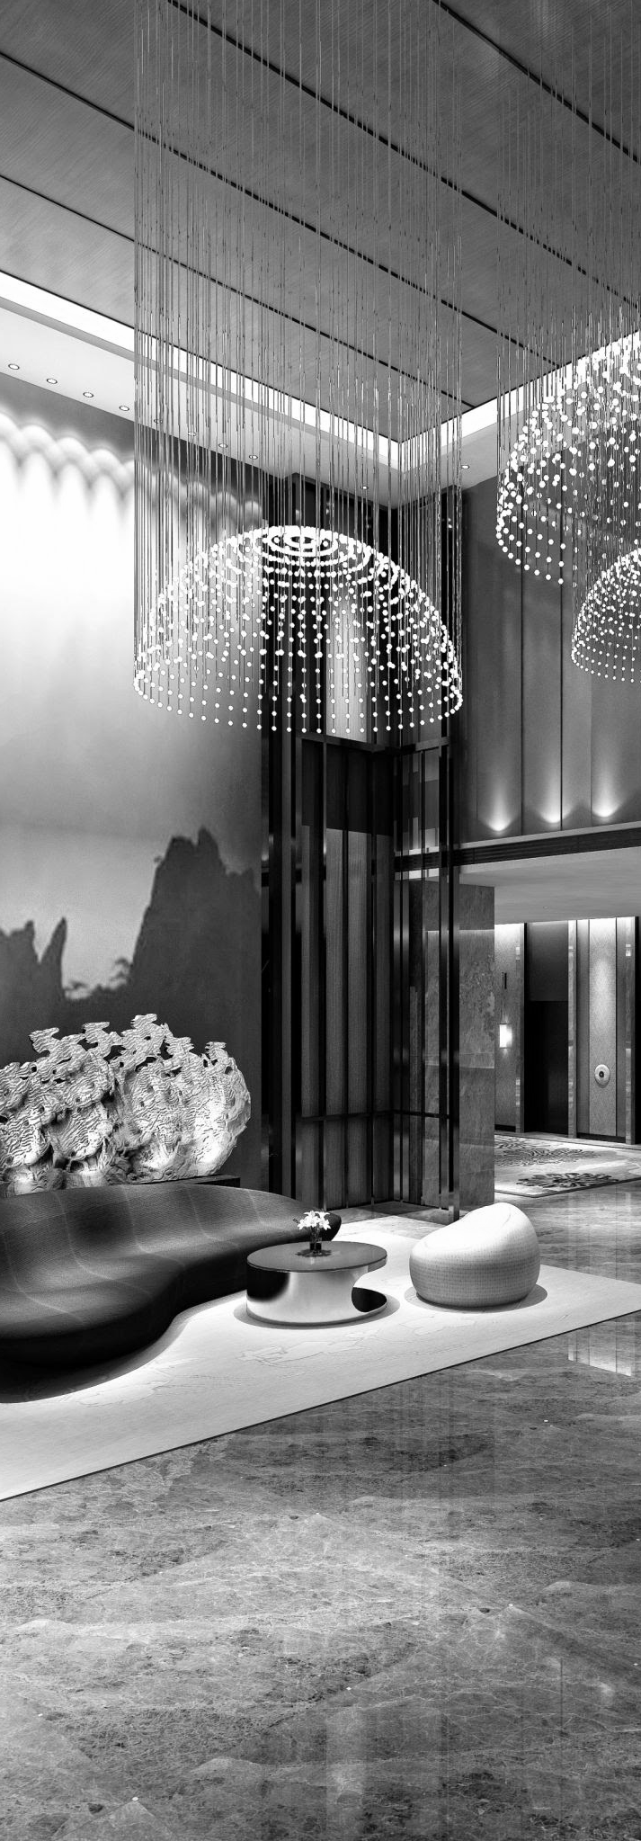
Integrate a Sound Card Compliant with Dante technology.
Use cases examples
BROADCAST
RADIO & TV
LIVE ENTERTAINMENT
MUSIC SERVERS
Reliably and securely connect multichannel recorders and players to a Dante network.
Take advantage of your processor's full power for your audio effects and use the card to manage the AoIP protocol.
Broadcasting multiple playlists for personalized selection in hospitality venues

Slide 15

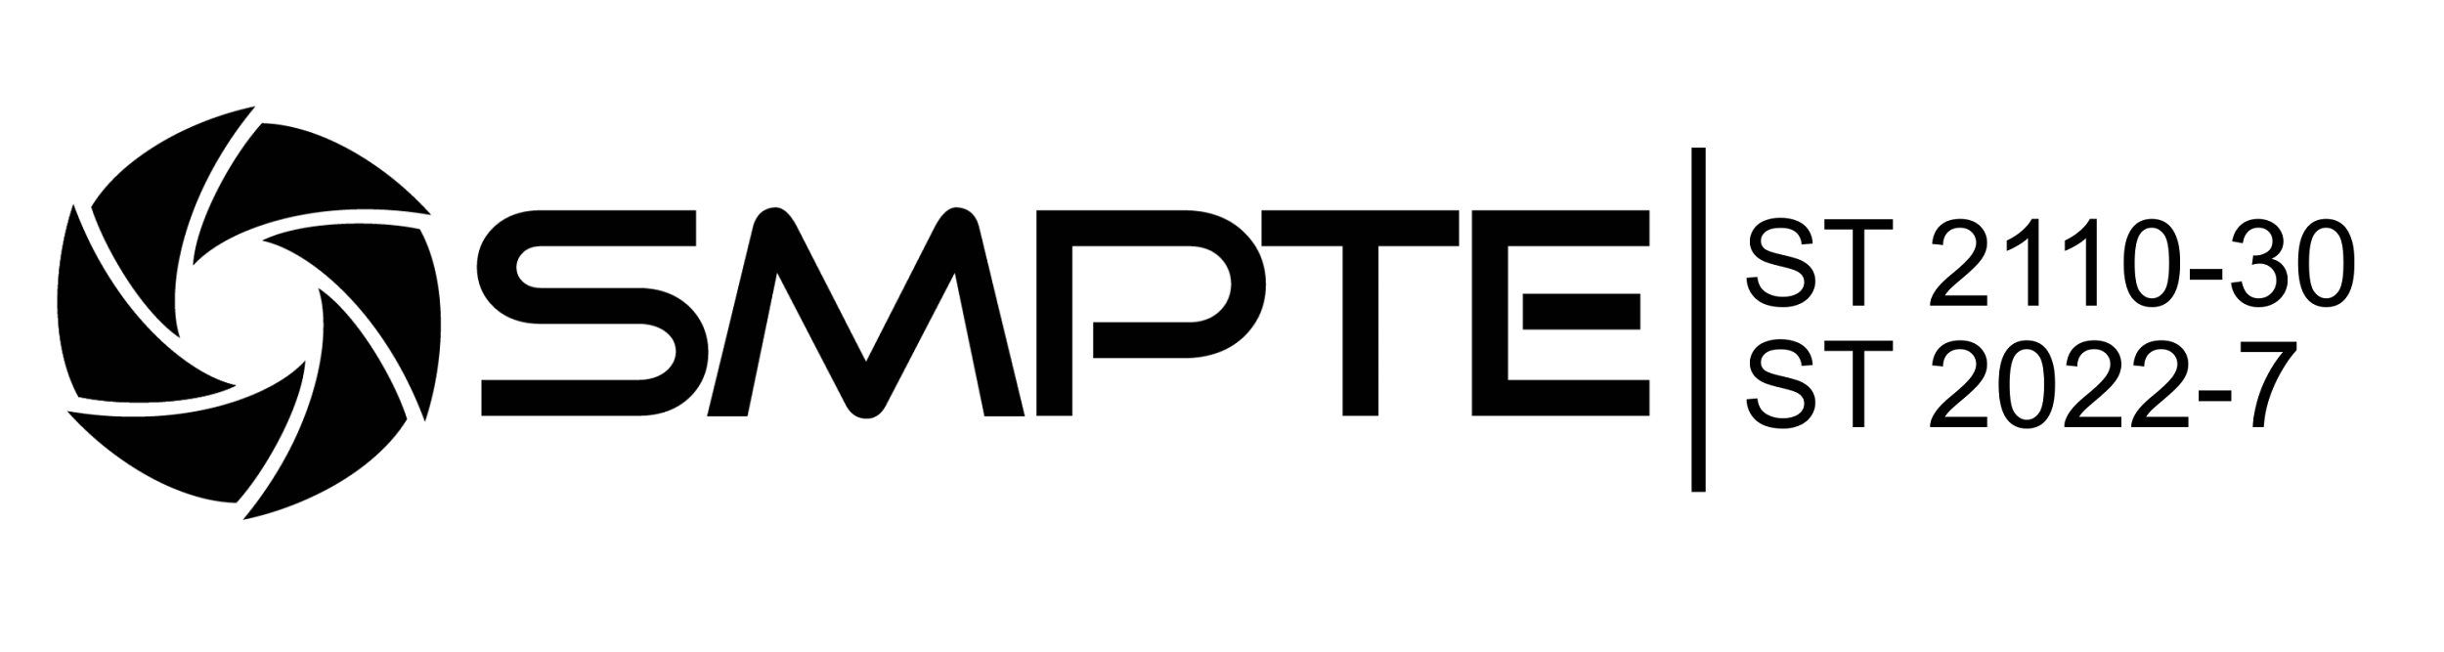
ALP-AES67.
Cards compliant with AES67, Ravenna, ST2110-30 and ST2022-7 tech.
FEATURES
Configurable in 2 or 4 Ethernet port version
Support for ST2022-7 redundancy mode or switch mode
Up to 64 input streams and 64 output streams
Support for "in-band" or "out of band" management
Dante interoperability via stream announcement in SAP
Management: WEB graphical interface, Aneman and MTDiscovery, NMOS based managers (NMOS IS-O4 and IS-O5)
Available in 2 versions:
ALP-AES67-64: 64 input channels and 64 output channels*
ALP-AES67-128: 128 input channels and 128 output channels*
*at 44.1 / 48 kHz, This number of I/O is halved when the sampling frequency is doubled.

Slide 16

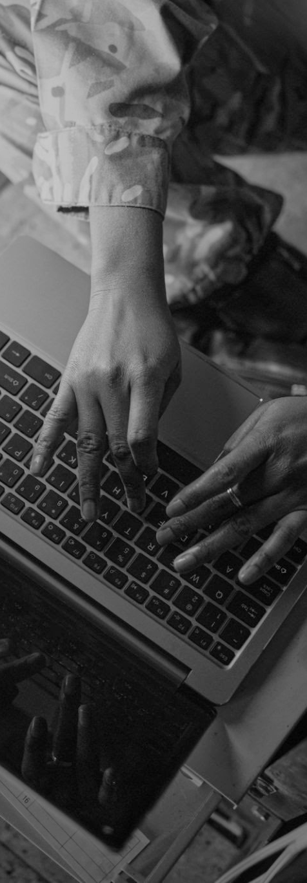

Integrate a Sound Card Compliant with AES67 technology.
Use cases examples
BROADCAST
RADIO & TV
DEFENSE & SECURITY
LIVE ENTERTAINMENT
Provides reliable ST2110 connectivity to workstations and playout and recording servers.
Associated with an analog to AES67 converter, store and record remotely all your critical communications simultaneously.
Gives robust high channel count AE67 connectivity to immersive sound processors and multichannel recorders.

Slide 17
ALP-X MANAGER
Application for Windows
Notes:
On top of the broadcast applications we just discussed, our sound cards are also used in other critical audio applications,
including military, aeronautical, maritime, civil defence, disaster recovery, and many more.
We have selected a few real life customer applications, but please note the use of our interfaces are limitless.

Slide 18
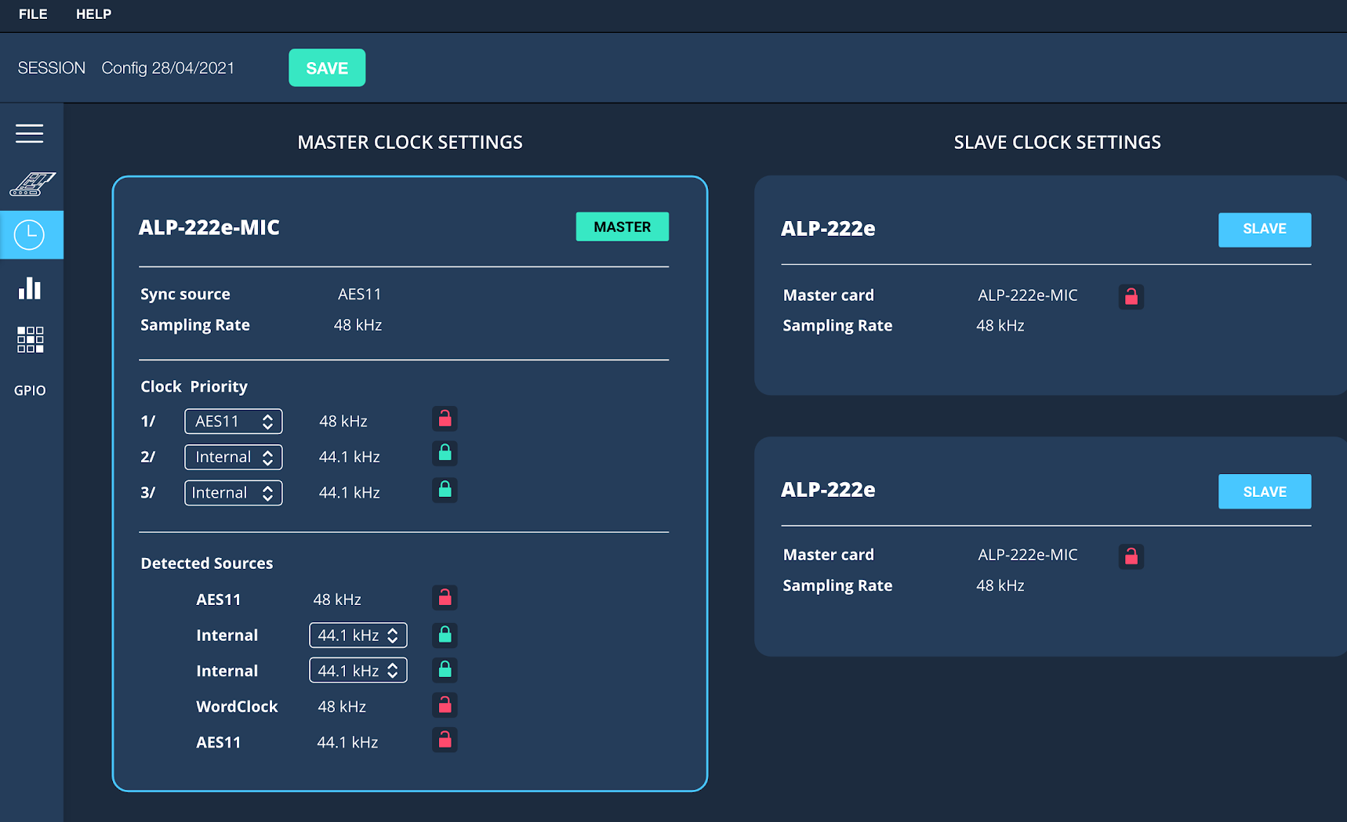
An Easy & Dedicated management of ALP cards settings.
Intuitive user interface
Automatic recognition of installed cards
Detection of firmware versions and firmware updates proposition
Easy setup of sampling clocks, input and output gains, mic inputs and routing/mixing
Monitoring of the input/output signal levels & GPIOs
Configuration via 3rd part application thanks to WASAPI APIs
‹#›
Notes:
The ALP-X manager will give you access to 4 stereo device on your workstation : 2 play and 2 record
You also have all the channels corresponding to the different input and output : 2 analog in and out, 2 digital in and out
Remember on the VX range ? You had to choose if you wanted to use analog or digital on the inputs and the output was playing the same audio on both analog and digital.
No more limitation with the ALP, it’s like a 4 mono channels card
You have access to everything at the same time. use the analog and the digital inputs at the same time AND send different audio to the outputs independently
But how ?

Slide 19
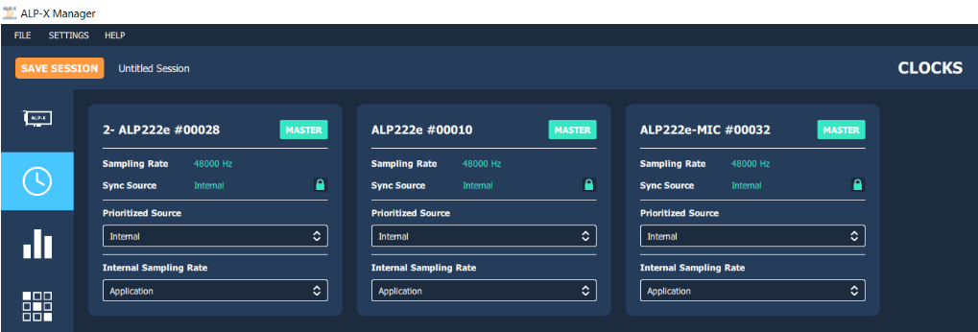
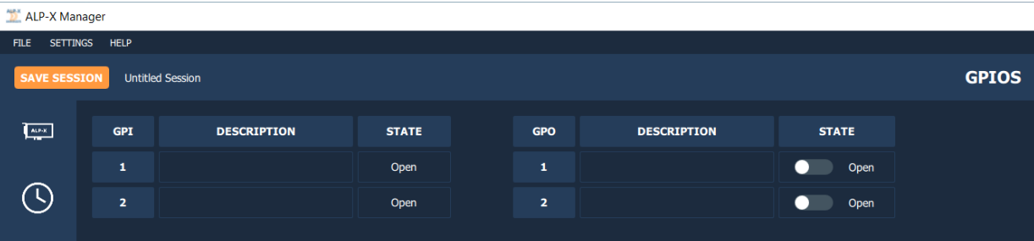
Global configuration, Clocks & GPIOs.
Clock settings:
  2 clock priorities,
  Clock sources: Internal, AES11, Word Clock
  Internal clock frequency: 8 kHz to 192 kHz
Display the status of GPIs & GPOs
Set the GPOs status
‹#›
Notes:
The ALP-X manager will give you access to 4 stereo device on your workstation : 2 play and 2 record
You also have all the channels corresponding to the different input and output : 2 analog in and out, 2 digital in and out
Remember on the VX range ? You had to choose if you wanted to use analog or digital on the inputs and the output was playing the same audio on both analog and digital.
No more limitation with the ALP, it’s like a 4 mono channels card
You have access to everything at the same time. use the analog and the digital inputs at the same time AND send different audio to the outputs independently
But how ?

Slide 20
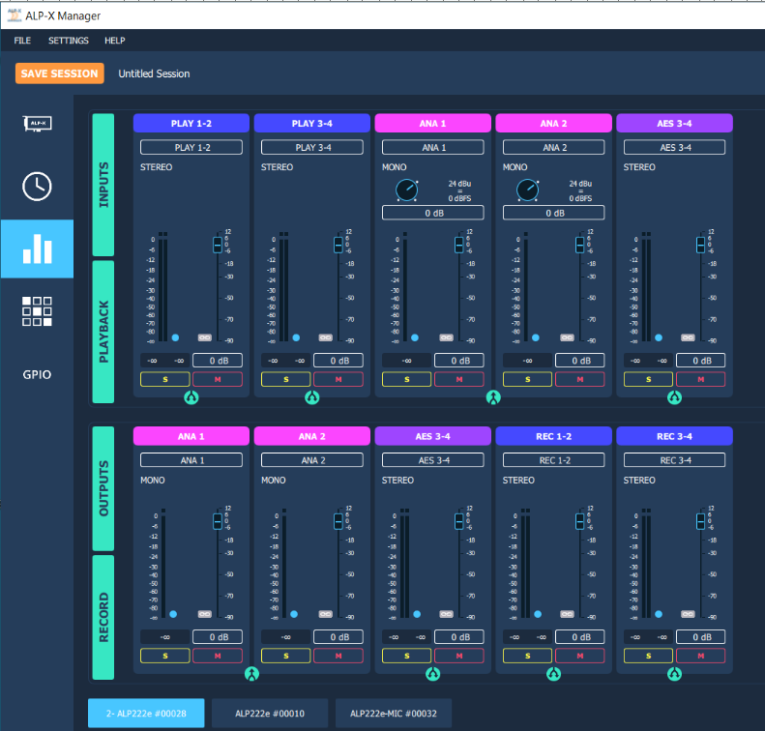
I/O Settings.
Level settings per ALP card
Input and output gains
Mic/Line level switching
48V phantom power
Vu-meters
Mono/stereo channels view
All the settings are accessible via the Wasapi API.
No settings on ALP-DANTE & ALP-AES67s
(only vumeters)
Note: No settings on ALP-DANTE & ALP-AES67s (only vumeters)
‹#›
Notes:
The ALP-X manager will give you access to 4 stereo device on your workstation : 2 play and 2 record
You also have all the channels corresponding to the different input and output : 2 analog in and out, 2 digital in and out
Remember on the VX range ? You had to choose if you wanted to use analog or digital on the inputs and the output was playing the same audio on both analog and digital.
No more limitation with the ALP, it’s like a 4 mono channels card
You have access to everything at the same time. use the analog and the digital inputs at the same time AND send different audio to the outputs independently
But how ?

Slide 21
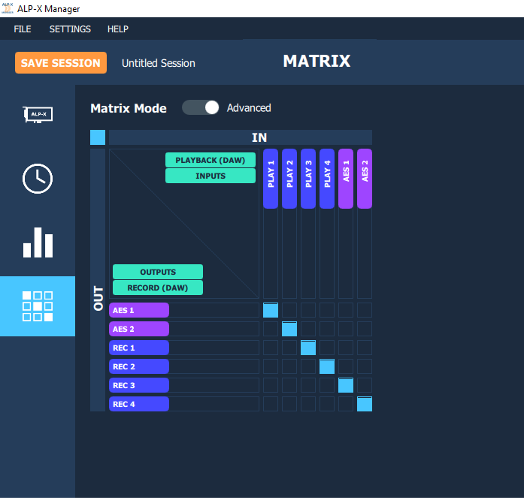
Input signals routing/mixing.
8 input channels / 8 output channels
1 mix of 8 inputs channels per output
Digital level for each component of a mix
This allows for the following use cases:
  playback of different audio contents on analog and digital outputs
  duplication of the output signal on analog and digital outputs
  simultaneous recording of analog and digital input signals
  Mixing before recording
  Monitoring of any input to any output
  Voice over
Note: no mixer on ALP-DANTE & ALP-AES67s
‹#›
Notes:
This is thanks to the new internal routing matrix.
With the matrix, you can route any input to any output
You have the channel from the Digital Audio Workstation, linked to your application, and you can route as you want and as many as you want the physical I/O of your card to these channels.

Slide 22



Thank you!

